Slide 1
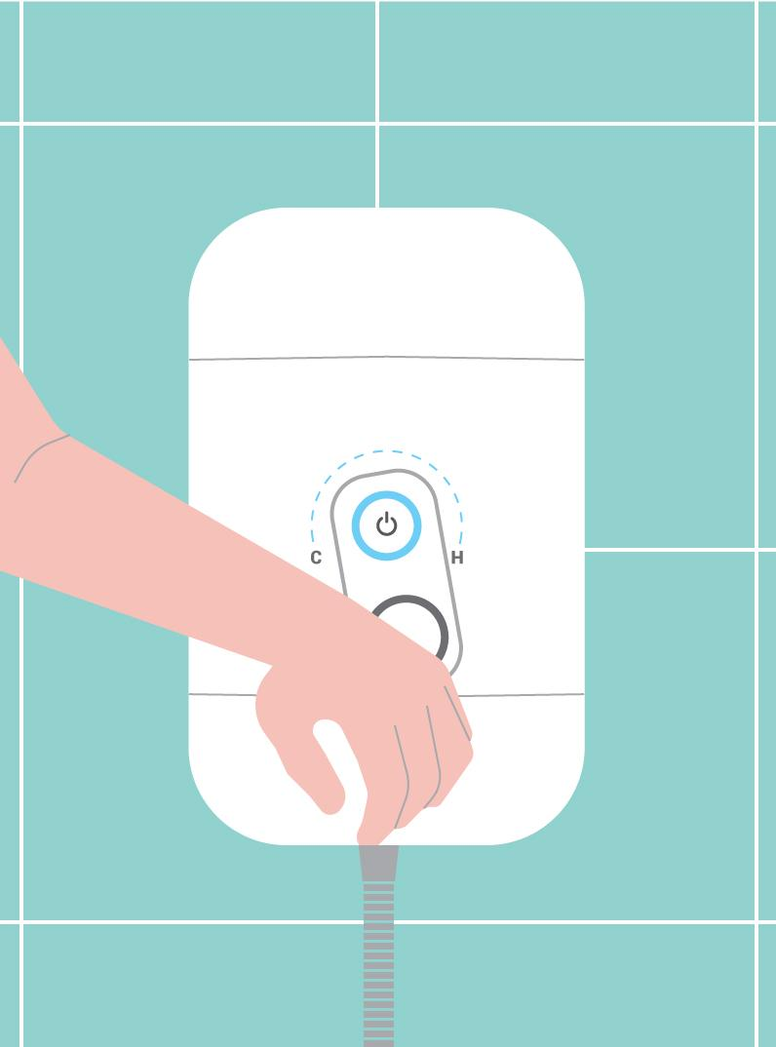
INCLUSIVE DESIGN:
ARTHRITIS-FRIENDLY BATHROOMS & KITCHENS
THOUGHTFUL ADAPTATION SOLUTIONS FOR PEOPLE LIVING WITH ARTHRITIS

Slide 2
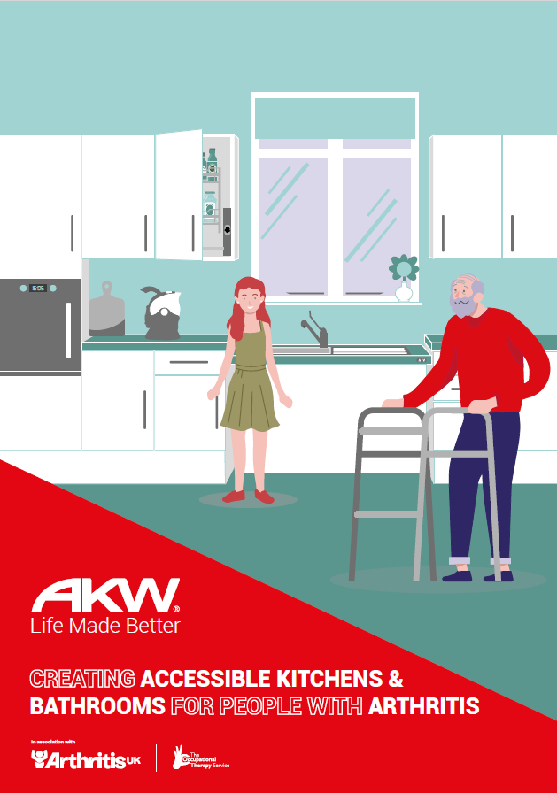
INTRODUCTION
More than 10 million people in the UK live with a form of arthritis, of which there are many types
Kitchens and bathrooms are high-risk spaces for pain and injury
AKW have collaborated with Arthritis UK and The Occupational Therapy Service to produce this presentation and our Arthritis design guide
Arthritis UK Focus Group: We listened to real people’s experiences to produce practical design guidance for Occupational Therapists

Slide 3



ABOUT THE COLLABORATION
AKW are a market leader in the supply and manufacture of accessible bathrooms, kitchens and daily living solutions
Arthritis UK (formerly Versus Arthritis) is the largest UK-based charity supporting people living with arthritis
The Occupational Therapy Service are an expert consultancy linking practice with inclusive design
The collaboration bridges the gap between lived experience, education and product innovation.

Slide 4
UNDERSTANDING ARTHRITIS
Arthritis is an umbrella term for a group of progressive conditions.
It’s not one single disease, but a term that refers to the swelling, stiffness and pain in one or more joints which typically worsen with age.
KEY STATISTICS
10 million people in the UK are estimated to be living with arthritis
Approximately 350,000 people are newly diagnosed with arthritis every year
In 2022, there were 12.7 million people in the UK aged 65+; by 2072 this is projected to be 22.1 million

Slide 5

UNDERSTANDING ARTHRITIS
The most common types of arthritis are:
Osteoarthritis
Rheumatoid arthritis
Psoriatic Arthritis
Axial Spondylarthritis
Whilst they tend to have some similar presentations, the causes are different, impacting severity, and therefore on activity engagement.

Slide 6
OSTEO & RHEUMATOID ARTHRITIS
OSTEOARTHRITIS
The most common form, affecting over 9 million people in the UK
It can affect any joint but most likely to affect joints that are weight bearing
Cartilage becomes worn through use and the repair process cause deformity which impacts on the joint structure
RHEUMATOID ARTHRITIS
An autoimmune condition which means that the body attacks healthy tissue
The impact is joint and tissue inflammation, stretching capsules
It also means that it can occur anywhere in the body, not just in joints (affecting vision and other functions)

Slide 7



FOCUS GROUP KEY FINDINGS
BATHROOMS
Baths are difficult to enter/exit and could be replaced with showers; some of the focus group felt that bathing helped with joint pain but the clinical evidence for this is limited
Steps, thresholds and trays in showers increase the risk of falls
Lever taps are preferred as these are easier to use
Toilet transfers are challenging when the pan is too low and push button flushes are difficult to use due to limited dexterity
50% or participants reported falls in the bathrooms, highlighting issues such as misuse of towel rails and radiators for support
Notes:
Arthritis UK, The Occupational Therapy Service and AKW hosted a focus group with people living with arthritis to learn more about their everyday experiences. Here is what we found.

Slide 8
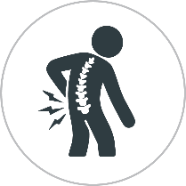
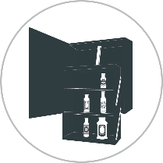
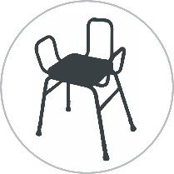
FOCUS GROUP KEY FINDINGS
KITCHENS
Worktops are often positioned either too high or too low, causing persistent joint strain
Regular difficulties accessing cupboards and low appliances
Poorly positioned plug sockets and limited space are common challenges
There was feedback that perching stools are sometimes helpful but significantly restrict movement and inhibit space
Many participants described preparing food outside the kitchen to avoid pain

Slide 9
FOCUS GROUP KEY FINDINGS
In addition, many participants felt that there were several issues beyond the design and inaccessibility of many of their homes:
There is a general lack of awareness about the grants available or adaptations options to people within the arthritis community
Assessments are reactive and tend to focus on crisis management rather than future-proofing and preventative strategies
Family and carer needs are often overlooked
Product packaging is not arthritis-friendly

Slide 10
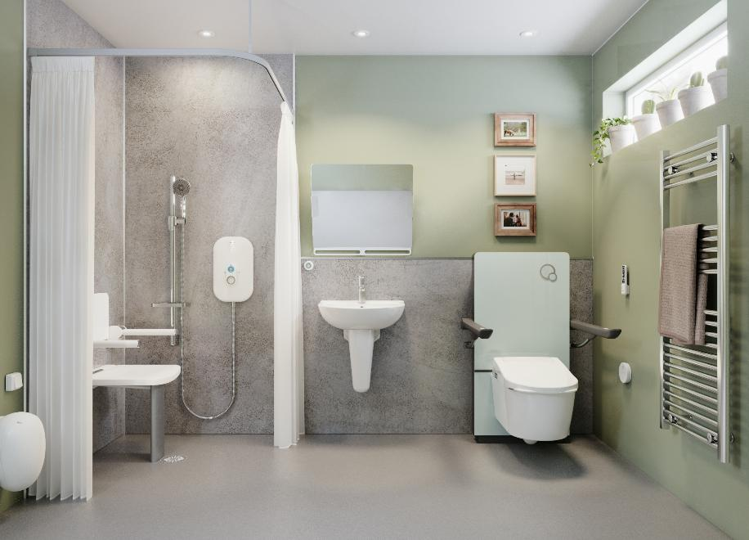
CLINICAL DESIGN STRATEGIES
BATHROOMS
Replace baths with low or fully level-access shower enclosures
Use lever handle or sensor operated taps
Fit raised or adjustable-height toilets
Use shower seat with softer arms and cushioning for greater comfort
Install slip-resistant flooring with a minimum R10 rating
Position grab rails for stability and function; also consider diameter and grip style to cater for their abilities

Slide 11
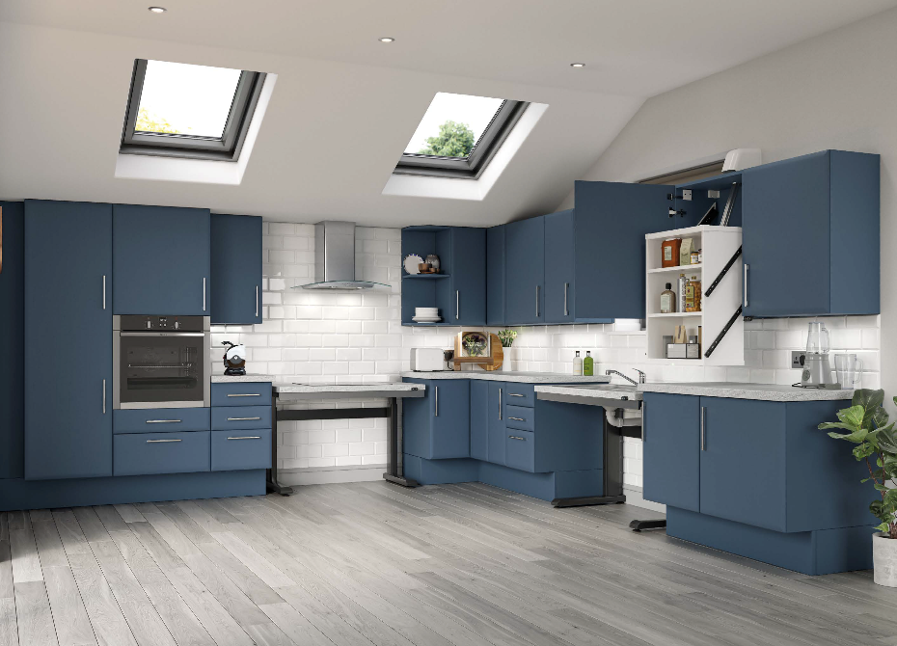
CLINICAL DESIGN STRATEGIES
KITCHENS
Use adjustable-height worktops and units with accessible storage options
Install large, low-pressure control buttons that are easy to use
Fit accessible sockets and mid-height appliances
Consider ergonomic, arthritis-friendly kitchenware, e.g. jar and can openers, and kettle tippers
Provide seating and resting points

Slide 12
CLINICAL JUSTIFICATION
ASSESS – Pain, fatigue, grip, reach and exercise tolerance
EXPLORE – Daily routines and goals
RECOMMEND – Short and long-term interventions
BALANCE – Function, aesthetics and safety
USE – Lived experience evidence to support accessible design recommendations

Slide 13
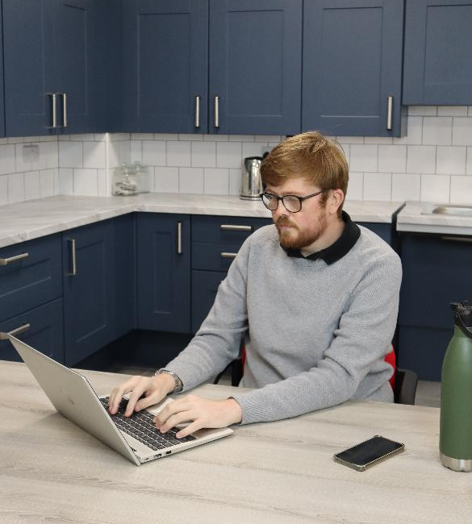
CASE STUDY – LEWIS, 32
Lewis has Psoriatic Arthritis which particularly affects the joints in his hands, shoulders and ankles, and is likely to spread further throughout adulthood.
At work, his employers have made changes, including:
Adjustable-height desk
Orthopaedic desk chair
Light-touch keyboard
He is in a rented property which makes major adaptations challenging. During flare ups, Lewis struggles with his mixer shower which has circular controls and opening/squeezing of bottles.
In the kitchen, he finds tasks such as chopping food, opening jars, and accessing low deep cupboards almost impossible.

Slide 14
10-POINT RECAP
Talk to the person about their habits and triggers of pain
Use logical layouts for predictability
Include seated and standing functionality
Plan for degenerative change
Remove clutter and trip hazards
Automate where feasible through Active Motion
Keep design simple and usable
Combine short and long-term interventions
Promote confidence through engagement
Collaborate with trusted suppliers who understand the need

Slide 15
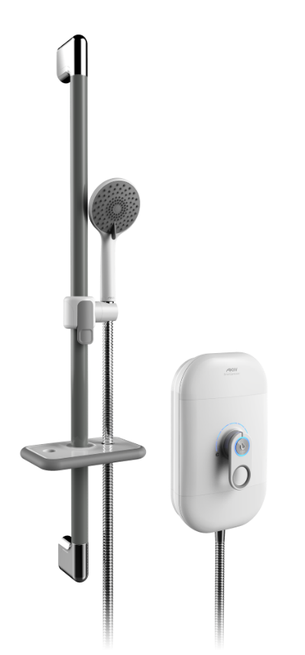
AKW BATHROOM SOLUTIONS
AKW SMARTCARE LEVER ELECTRIC SHOWER
Controls are clear and simple to use with only one push button controlling the power
Easy-to-use lever changes temperature settings which supports more gross motor control and less dexterity
Handset holder is adjusted using the palm of your hand which limits the need for fine motor skills and grip strength
Riser rail is load-bearing and can be used as a grab rail for stability, supporting up to 23.5st (150kg)

Slide 16
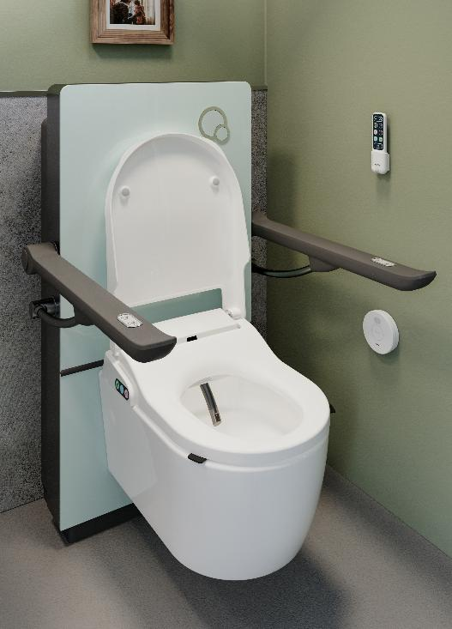
AKW BATHROOM SOLUTIONS
AKW RISE & FALL BIDET
Features a height-adjustable pan which makes standing or sitting easier, helping posture, joint angles and effort
Using a bidet removes the need for the person to use toilet paper and the motor skills required to complete the task effectively
Optional SENSOR OPERATED SWITCH allows Bidet settings to be activated by pushing a large button or waving in front of a sensor, which can be attached to the wall or floor
Seat tabs and moulded lid lift assist features are easier for people with limited dexterity to use

Slide 17
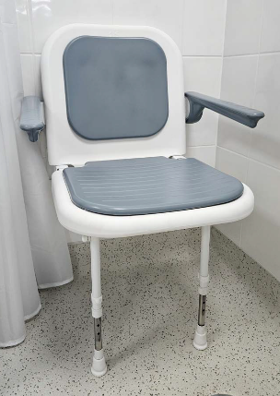
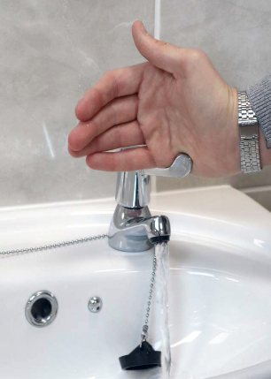
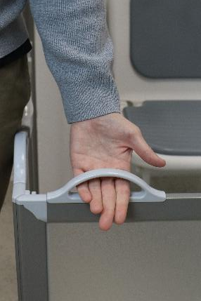
AKW BATHROOM SOLUTIONS
4000 SERIES SHOWER SEAT was highlighted by the focus group as the most supportive of their joints and most comfortable to sit on
Shower enclosures with D-SHAPED HANDLES offer full-hand grip, minimising strain on fingers and wrists
LEVER HANDLE TAPS are an easy-to-use alternative to twist taps which can also be operated by a closed fist or elbow

Slide 18
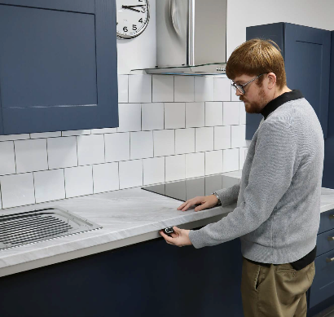
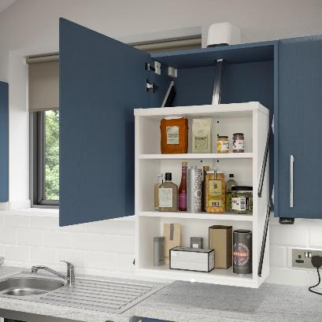
AKW KITCHEN SOLUTIONS
ACTIVMOTION RISE & FALL WORKTOPS are easily adjusted using a push button, allowing simple and regular position changes; they’re also a good future-proof solution for people with a degenerative condition
ACTIVMOTION GLIDE WALL UNITS descend at the push of a button or by remote control, bringing the contents of the cupboard down and outwards for easier access

Slide 19
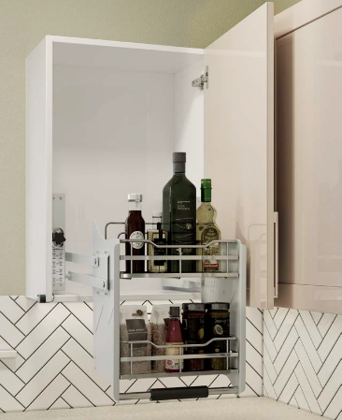
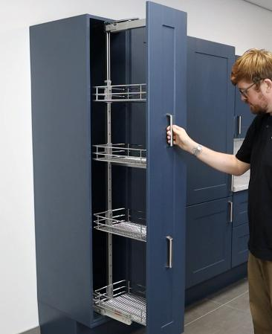
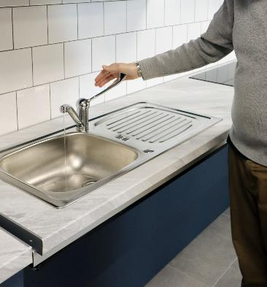
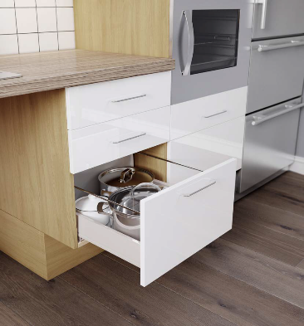
AKW KITCHEN SOLUTIONS
Bilateral access LARDER UNITS provide maximum storage at a good functioning height
LEVER HANDLE TAPS are an accessible, easy-to-use solution for people with limited dexterity
PULL-DOWN OR SLIDE-OUT BASKETS eliminate stretching and overreaching when accessing items
Specify DEEP DRAWERS over standard cupboards as they can be easier to access
Use D-SHAPED HANDLES which provide enough clearance for a full hand if fine motor strength is weakened

Slide 20
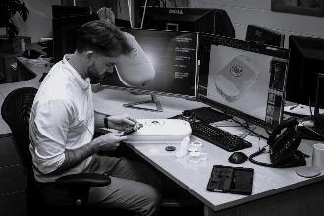
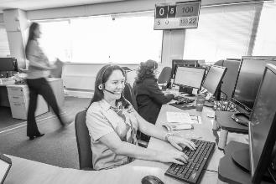
LIFE MADE BETTER
From a small Worcestershire business, AKW has grown into a market-leading international operation:
200+ UK-based colleagues
Over 1 million satisfied customers
World-class manufacturing facilities
Dedicated 30+ vehicle fleet providing door-to-door service
3 national distribution warehouses covering over 3.5m sq. feet
60+ sales and surveying experts nationwide

Slide 21
OUR STORY
1982 | Founded by Anthony Keith Webb in Worcester, UK
1996 | Began manufacturing accessible kitchens
2002 | Launched own range of grab rails and shower seats
2014 | Released dementia-friendly bathroom design guide
2015 | Introduced AKW electric showers and wet room formers
2022 | Contour Showers Ltd acquired
2024 | Opened manufacturing facility, showroom and distribution centre in Middlewich, UK
2025 | Launched AKW Virtual Showroom and Clinical Hub

Slide 23
RESOURCES
CREATING ACCESSIBLE KITCHENS AND BATHROOMS FOR PEOPLE WITH ARTHRITIS
Written in collaboration with The Occupational Therapy Service and Arthritis UK, this guide aims to equip occupational therapists and specifiers with clinical strategies and design considerations, that are based on service-user insight and real-world applications.
Download for free on the AKW website.

Slide 24
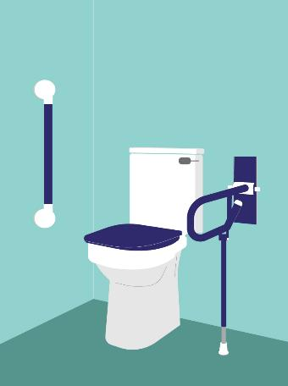


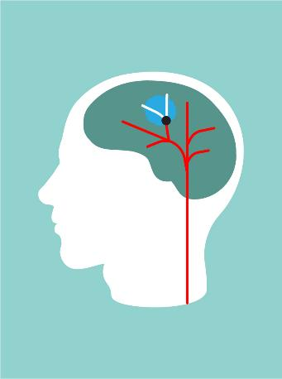
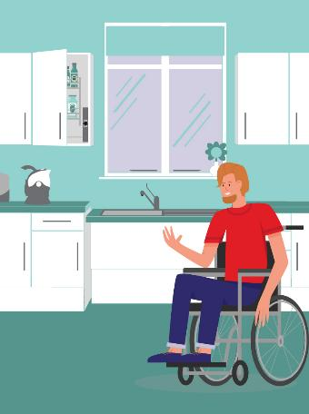
RESOURCES
AKW CLINICAL HUB – Collection of digital resources which offer condition-specific information to support occupational therapists and specifiers – www.akw-ltd.co.uk/clinical-hub
VISUAL IMPAIRMENT
DEMENTIA
ARTHRITIS
STROKE
WHEELCHAIR ACCESSIBILITY
Notes:
For more product information and best practice design advice on specifying for clients with a range of conditions and care requirements, please visit the AKW Clinical Hub, which is home to a collection of digital resources, including videos and educational guides.

Slide 25
THANK YOU
FOR YOUR TIME
PLEASE FEEL FREE TO ASK US ANY QUESTIONS YOU MAY HAVE.
Notes:
Thank you so much for your time today, I hope this session has been beneficial; if you have any questions, please feel free to ask us.

