Slide 1
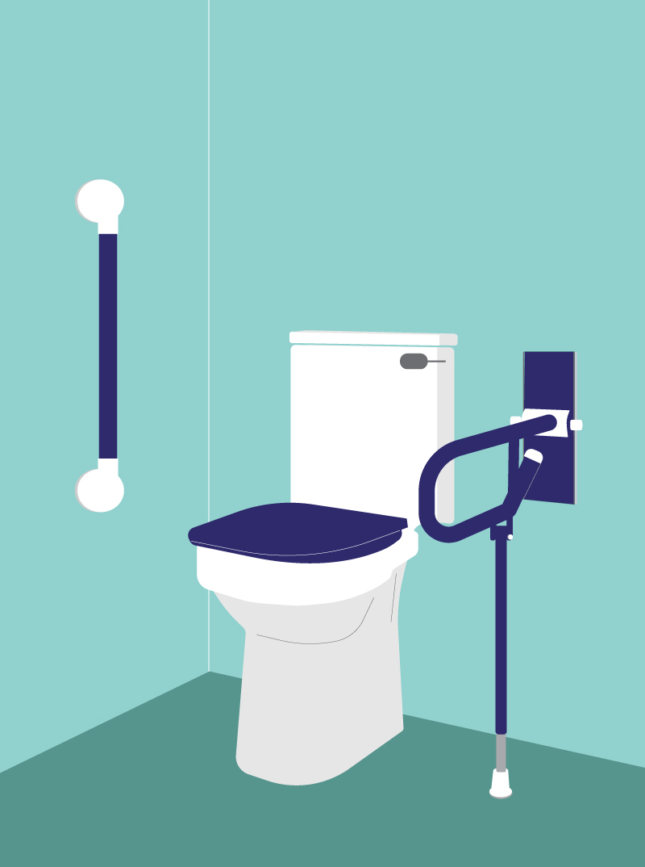
INCLUSIVE DESIGN: BATHROOMS & KITCHENS FOR VISUAL IMPAIRMENT
BEST PRACTICE DESIGN ADVICE FOR PEOPLE LIVING WITH VISUAL IMPAIRMENT

Slide 2
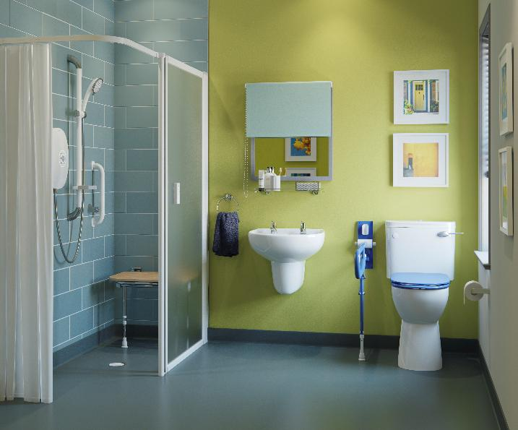
WHY INCLUSIVE DESIGN MATTERS
1 in 30 people in the UK live with a visual impairment
Over 360,000 people are registered as sight impaired or severely sight impaired
Visual impairment impacts safety, confidence and independence in the home

Slide 3
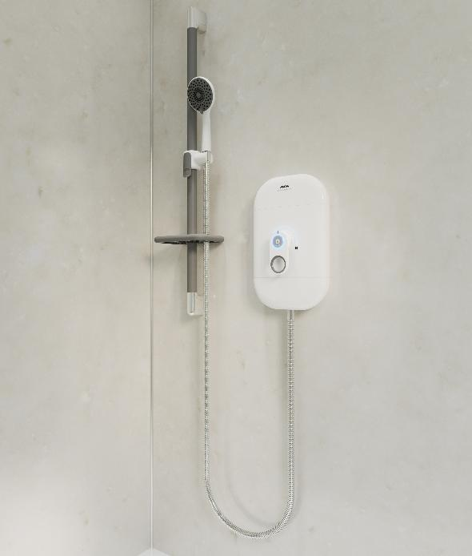
UNDERSTANDING VISUAL IMPAIRMENT
Sight loss that is not correctable by glasses or lenses
Common causes include glaucoma, macular degeneration, neurological conditions and diabetes
Effect include reduced depth perception, visual field loss and glare sensitivity

Slide 4
WHY DESIGN IS IMPORTANT
REAL & PERCEIVED RISK
Bathrooms and kitchens are high risk areas within the home for people with visual impairment
Common hazards occur in these spaces such as slips and burns
Accessible design significantly reduces risk of accidents and supports the individual’s independence

Slide 5
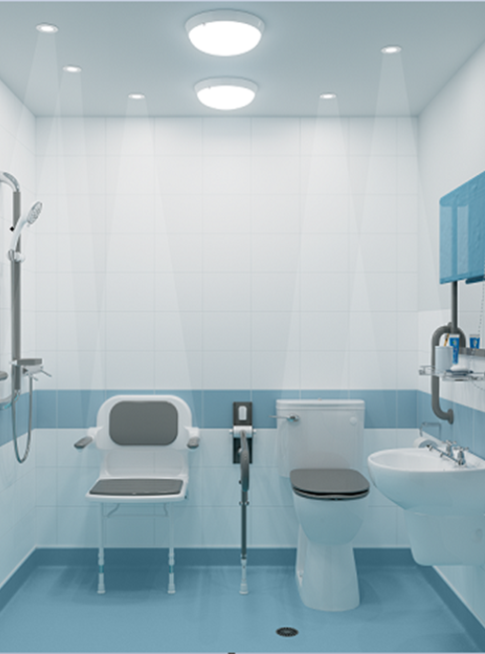
LIGHTING
USING LIGHTING TO SUPPORT PEOPLE WITH VISUAL IMPAIRMENT

Slide 6
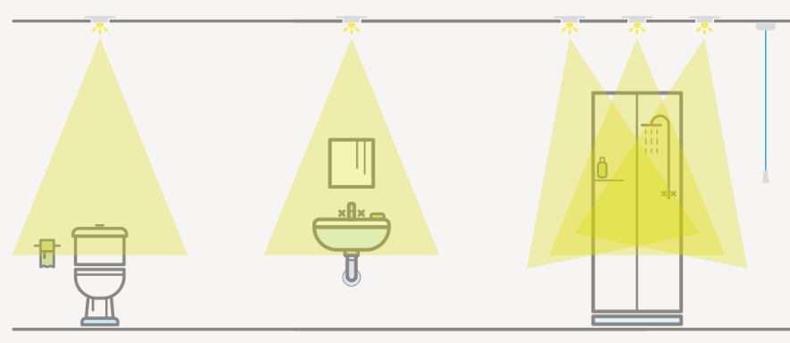
LIGHTING
PRINCIPLES
Good lighting will ensure safety and security, but for someone with a visual impairment, it can be used specifically to maximise ability to engage in the activity whilst also reducing risk.
According to the Thomas Pocklington Trust, a charity dedicated to delivering positive change to those with sight loss, big lighting improvements can be achieved by introducing some simple design specifications, which are supported by a robust evidence base.

Slide 7
LIGHTING
SPECIFICATIONS
Use task-focused lighting which illuminates specific activity areas such as the sink, toilet, shower, hob and food preparation areas
Halving the distance between light and the object increases visual acuity x 3
Recommend 600-700 lumens for standard lighting, and 800–900 lumens for task-focused lighting
Reduce glare with non-reflective materials
Use adjustable lighting to accommodate for varying natural light
Maximise natural light in kitchen and bathrooms

Slide 8
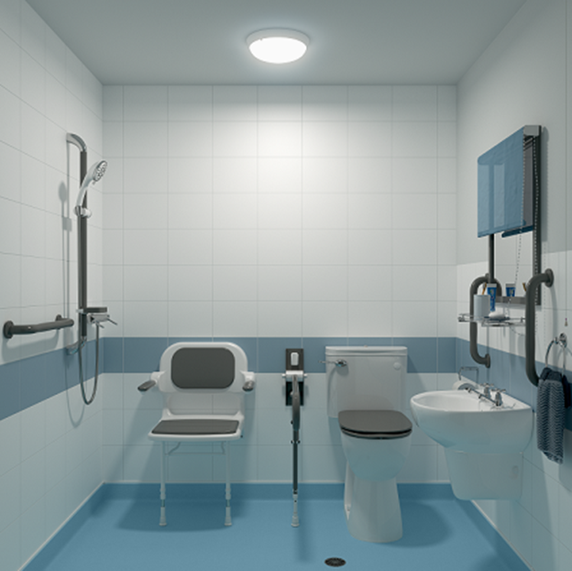

LIGHTING
STANDARD LIGHTING: Items blend together with increased shadowing
TASK-FOCUSED LIGHTING: Key items stand out clearly, reduced shadowing

Slide 9
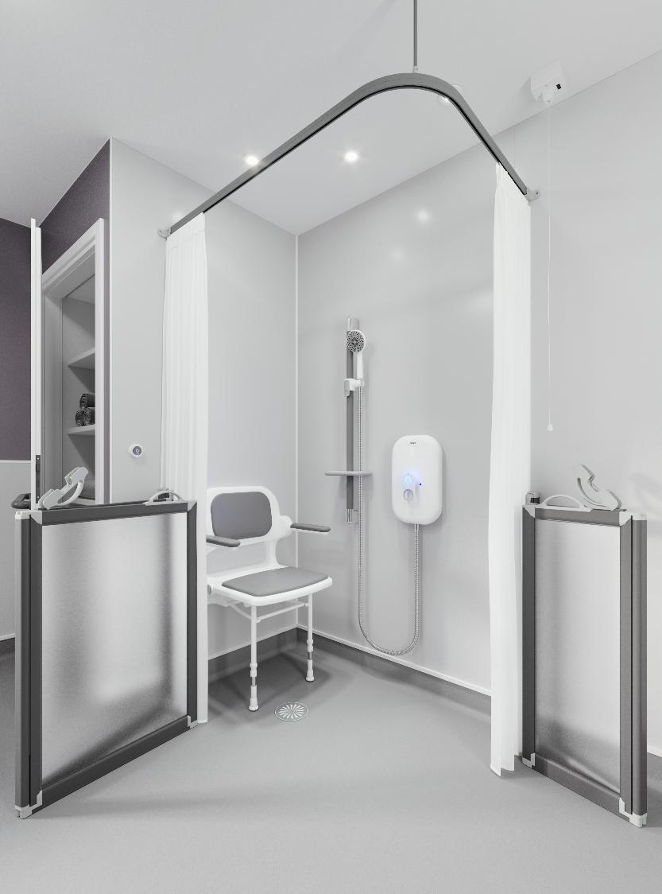
COLOUR CONTRAST
USING COLOUR CONTRAST TO SUPPORT PEOPLE WITH VISUAL IMPAIRMENT

Slide 10
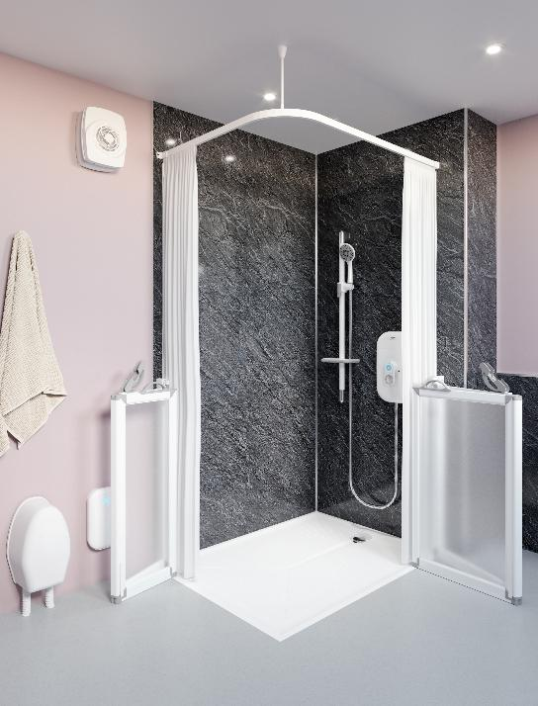
COLOUR CONTRAST
PRINCIPLES
Colour contrast is critical in supporting people living with visual impairment.
Lighting should be used to accentuate the colour contrast and not be used as a replacement.
For example, tiling should contrast the wall colour, which is then highlighted with task-focused lighting; the wall colour should also contrast against the floor, which is highlighted with well-placed general illumination.

Slide 11
COLOUR CONTRAST
SPECIFICATIONS
LRV (Light Reflective Value) difference of greater than 30 points ensures sufficient colour contrast
Use colour contrast to highlight fixtures such as the toilet seat, rails, sinks, as well as room boundaries like the floor and walls
Contrast can also be used to identify specific areas within a room, such as the shower zone or toilet zone
Preference is often to use shades of the same colour over different colours, particularly within domestic environments

Slide 12
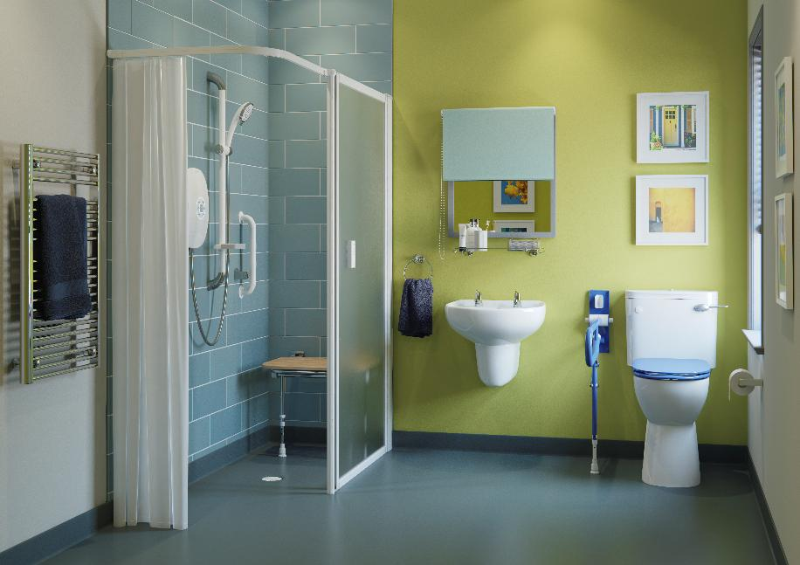
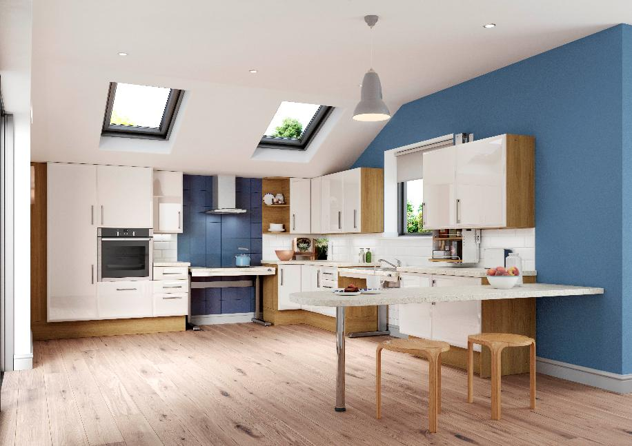
COLOUR CONTRAST
EXAMPLES
Notes:
Here is a visual example of the difference Task-Focused Lighting can make in a small bathroom space.
As you can see on the left, the bathroom features a single standard LED ceiling light, which results in a large amount of shadowing – something that can be confusing for someone with dementia. The bathroom also lacks the brightness needed to carry out activities as effectively when compared to the image on the right.
The second bathroom benefits from double the amount of light from standard LED ceiling lights which have been positioned in such a way to reduce the shadowing, it also includes several narrow beam task-focused spotlights which have been installed over the sink, toilet, shower seat, and shower unit to make them stand out more.

Slide 13
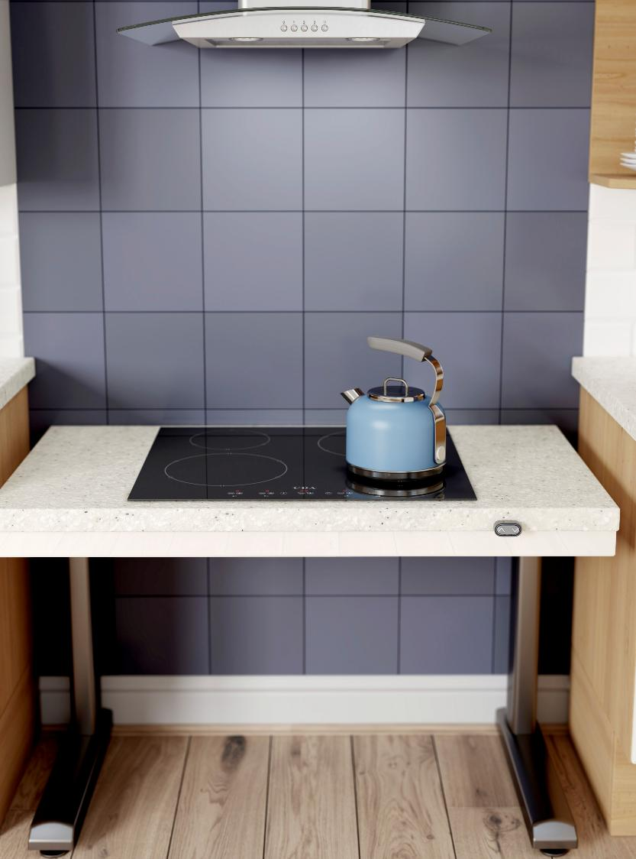
KITCHEN & BATHROOM DESIGN
MAKING THE HOME SAFER FOR PEOPLE WITH VISUAL IMPAIRMENT

Slide 14
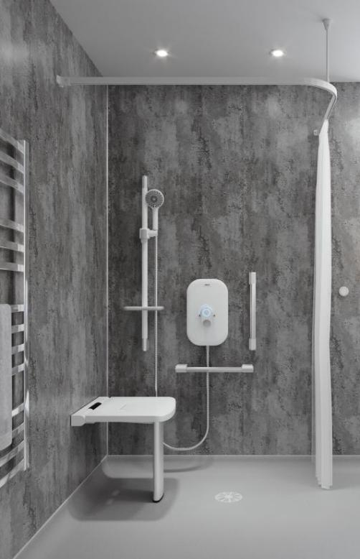
KITCHEN & BATHROOM DESIGN
LAYOUT
Maintain the existing, familiar layout wherever possible
Items used more frequently need to always be accessible and where the person would expect to find them
Make sure circulation routes are obstacle free
Box in or ideally remove any exposed pipework

Slide 15
KITCHEN & BATHROOM DESIGN
FLOORING
Clear contrast from floor to wall colour aids proprioception and depth perception
Flush access and level flooring throughout is ideal to reduce risks
Block colours are recommended and patterns avoided
Non-reflective, matt flooring eliminates glare and reflective properties
Texture changes to provide sensory feedback can be useful in identifying specific areas within a room for the most visually impaired

Slide 16
BATHROOM DESIGN
TOILETS & BASINS
A high-contrast toilet seat and flush control will help the person to locate them
If possible, make space around the toilet to support free movement
Consider how an AKW Bidet or wash/dry toilet might impact dignity and independence
Contrast between basin, wall and floor will increase acuity
Mixer taps may be easier to use as they require less fine motor skills to adjust

Slide 17
BATHROOM DESIGN
SHOWERS
Models that feature raised, tactile controls for temperature control and flow, or provide auditory feedback when settings are changed are best
Be aware that some showers can also be operated with a remote
Ensure there is no externally heated pipework
Thermostatically-controlled showers reduce risks
Shower areas are safer if they offer full level-access

Slide 18
BATHROOM DESIGN
SHOWER SCREENS
Avoid highly reflective glass shower screens, however, if there is no other choice, then ensure task-focused lighting is angled to illuminate the area without reflecting directly off the screen and causing unnecessary glare
Frosted screens are a good option if the person has a carer
Enclosed shower areas are not always the best thing for people with certain conditions, such as MS, which can be aggravated by hot and steamy environments; in this circumstance, pay extra attention to ventilation and temperature control

Slide 19
KITCHEN DESIGN
OVENS
Controls that are tactile or provide auditory feedback are required
Sliding or fold-away doors help to prevent burns and take up less space
Internal lighting is essential for someone with impaired vision
Silicone aids are available to create contrast and protection from the front edge of the oven shelves or trays
HOBS
Inductions hobs tend to provide the best visual feedback
Gas flames tend to be more difficult to see, therefore are more of a hazard
Choose devices that feature tactile controls or provide auditory feedback

Slide 20
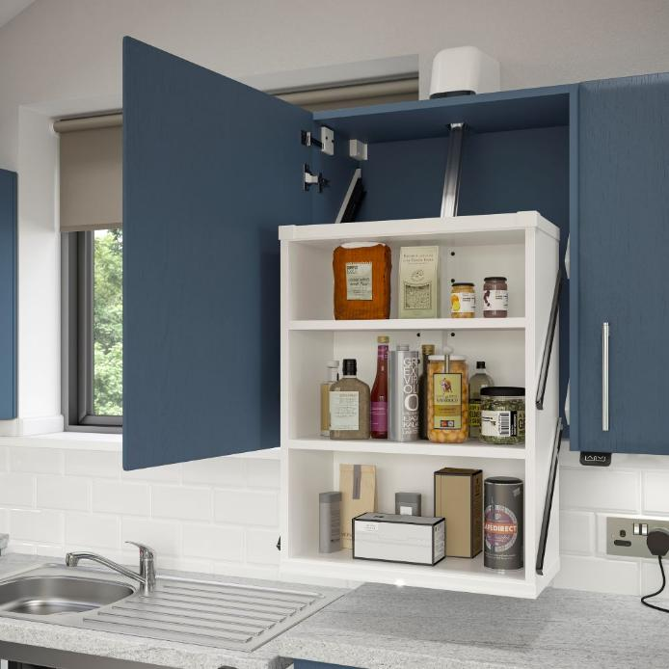
KITCHEN DESIGN
CUPBOARDS
Question whether cupboards need hinged doors as sliding or folding might work better
Handle colours should contrast against doors
Avoid highly reflective glass that can cause glare
Consider automatic internal lighting

Slide 21
KITCHEN DESIGN
OTHER SUGGESTIONS
Find a way of contrasting white goods or clearly identifying the difference
Position the fridge close to preparation areas and dishwasher by the sink
All appliances should provide physical or auditory feedback
Use mixer taps where possible
Choose accessories such as towels, kettles and containers that contrast
Ensure sockets and switches are easy to access
Colour contrast between the sink and the worktop

Slide 22
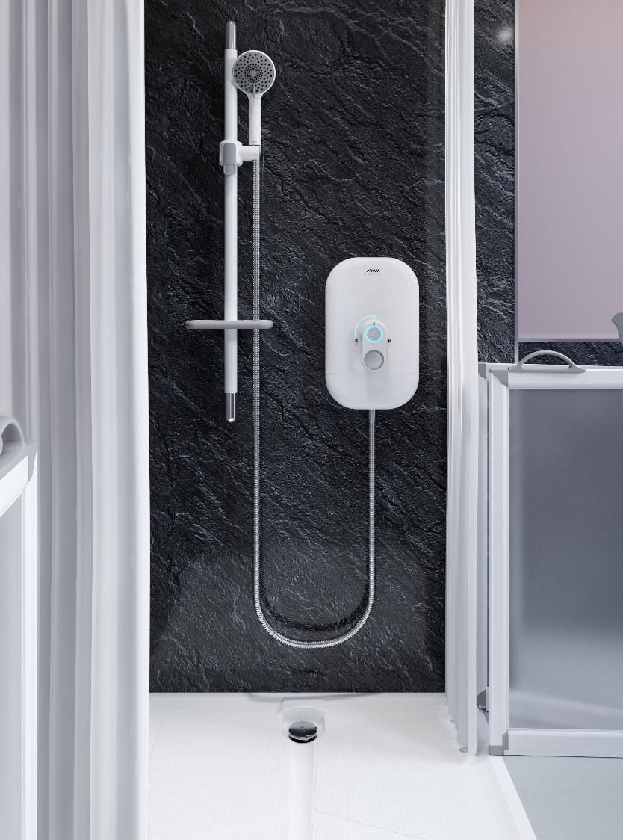
AKW SOLUTIONS
DESIGNED FOR INDEPENDENCE & DIGNITY

Slide 23
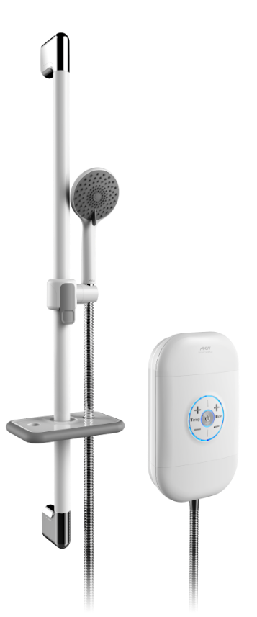
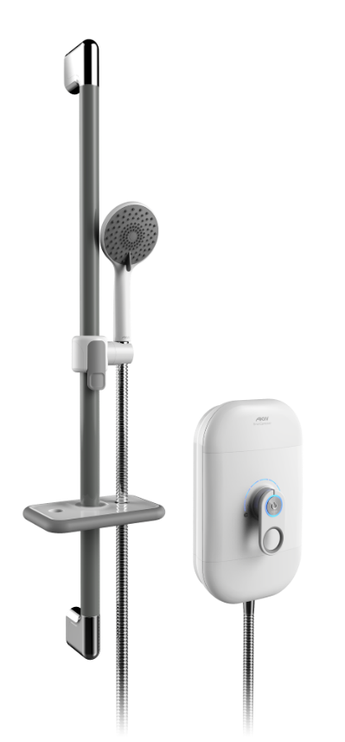
AKW SOLUTIONS
AKW SMARTCARE ELECTRIC SHOWERS
Controls are clear and simple to use with tactile, colour contrasting elements
Audible clicks/beeps and LED display
Matt-finish central control panel for reduced glare
Care accessory kit comes with contrasting riser rail offered in multiple colours

Slide 24



AKW SOLUTIONS
MATT-FINISH WALL PANELS
Single colour panels with no pattern and a matt finish that vastly reduces glare
Light yet warm colours help create contrast against accessories without being too clinical
Easy to keep clean with fewer joins and dirt traps
SUPER WHITE BUMPY TILES
Bumpy tile surface helps to reduce glare and offers high contrast against accessories
Irish Cream
Warm Grey

Slide 25
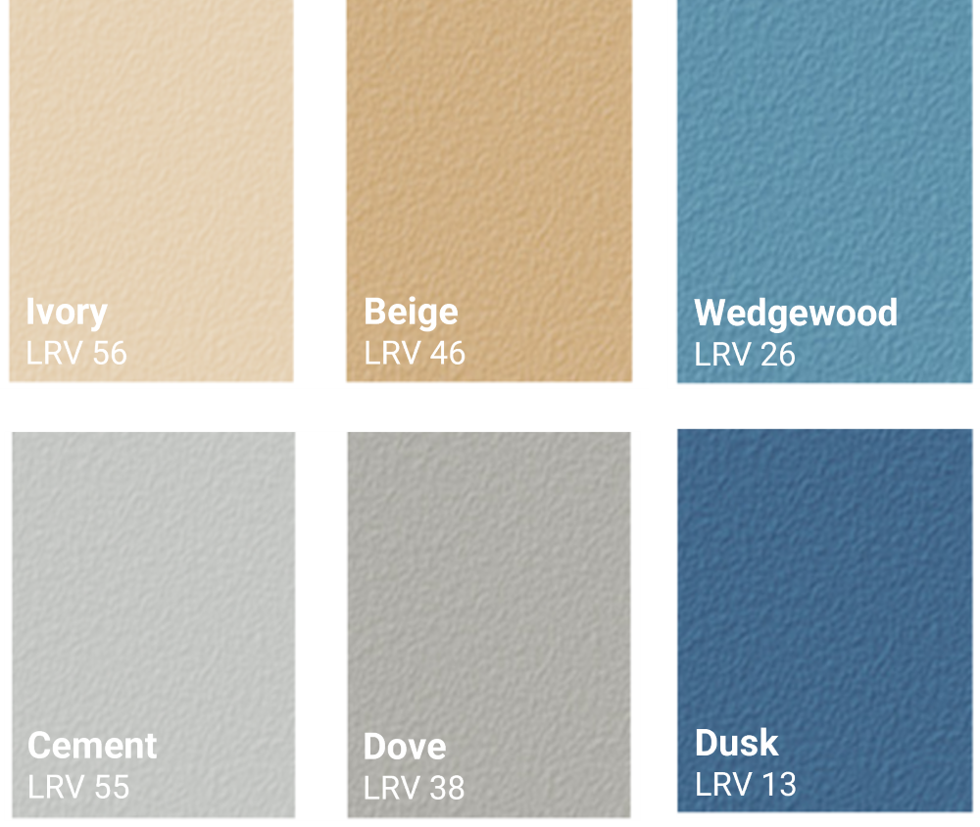
AKW SOLUTIONS
AKW SAFETY FLOORING
No pattern or flecks
Highest barefoot slip-resistance rating when tested in wet and soapy conditions (Class C: DN51097)
Warm, homely traditional colour pallet, not institutional

Slide 26
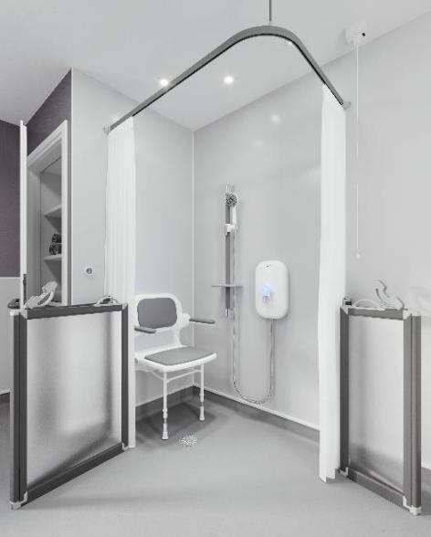
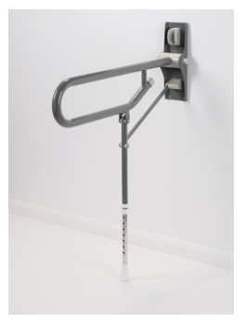
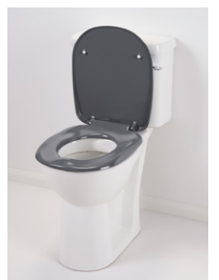
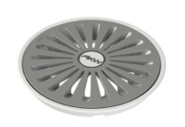
AKW SOLUTIONS
ACCESSORIES WITH HIGH COLOUR CONTRAST
Care screens and curtain rails with colour contrasting elements to help them to stand out
Ergonomic toilet seats, grab rails, and shower seats with contrasting cushions and arms
Mid-grey and white waste covers for vinyl covered wet room floors

Slide 27
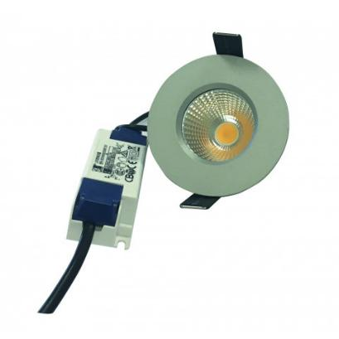
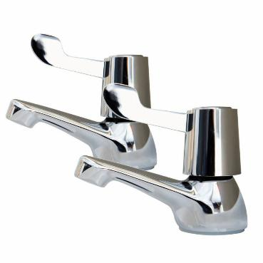
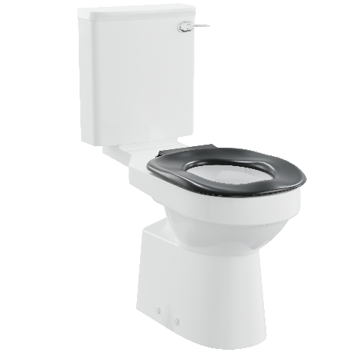
AKW SOLUTIONS
OTHER SOLUTIONS:
Task-Focused Lighting to highlight key activity areas in the bathroom
Lever handle taps with familiar red and blue temperature indicators
Lever handle cistern flush for ease of use and familiarity

Slide 28
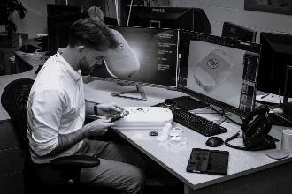
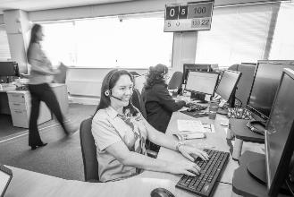
LIFE MADE BETTER
From a small Worcestershire business, AKW has grown into a market-leading international operation:
200+ UK-based colleagues
Over 1 million satisfied customers
World-class manufacturing facilities
Dedicated 30+ vehicle fleet providing door-to-door service
3 national distribution warehouses covering over 3.5m sq. feet
60+ sales and surveying experts nationwide

Slide 29
OUR STORY
1982 | Founded by Anthony Keith Webb in Worcester, UK
1996 | Began manufacturing accessible kitchens
2002 | Launched own range of grab rails and shower seats
2014 | Released dementia-friendly bathroom design guide
2015 | Introduced AKW electric showers and wet room formers
2022 | Contour Showers Ltd acquired
2024 | Opened manufacturing facility, showroom and distribution centre in Middlewich, UK
2025 | Launched AKW Virtual Showroom and Clinical Hub

Slide 31
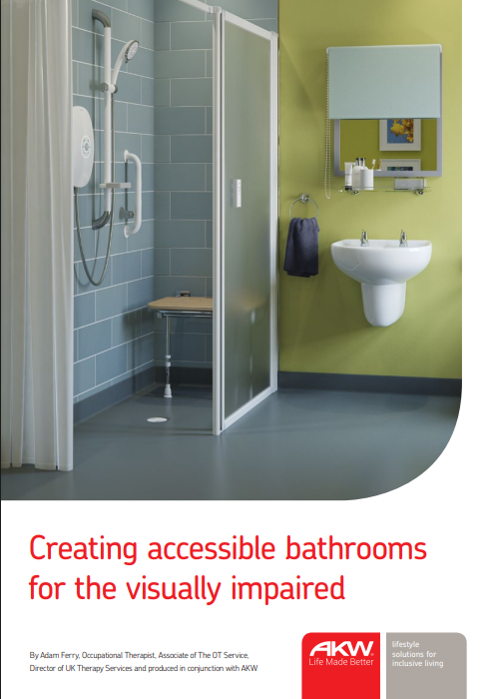
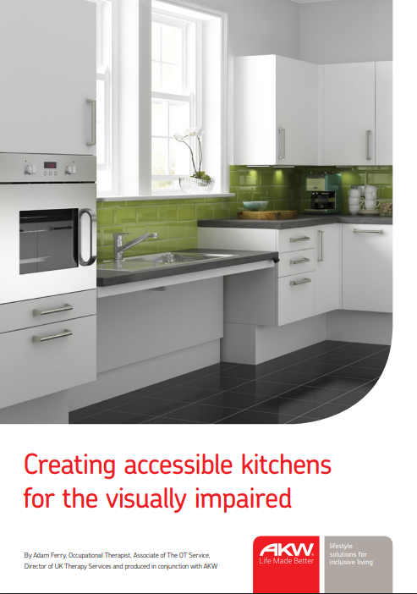
RESOURCES
CREATING ACCESSIBLE BATHROOMS & KITCHENS FOR PEOPLE WITH VISUAL IMPAIRMENT
Written by Adam Ferry of The Occupational Therapy Service and produced in conjunction with AKW, these guides aim to equip specifiers with design advice to support people living with visual impairment.
Download for free on the AKW website.

Slide 32
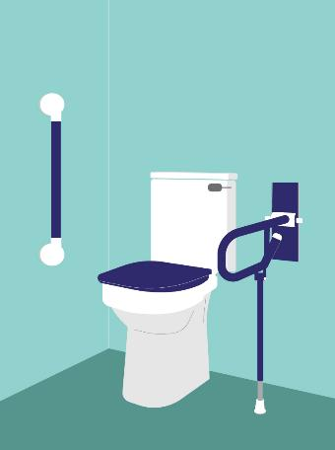

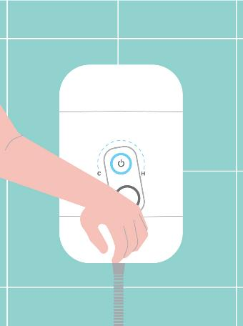
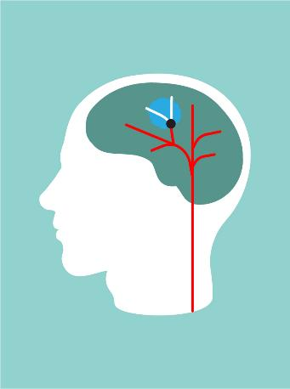
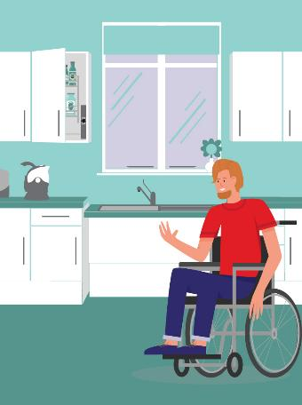
RESOURCES
AKW CLINICAL HUB – Collection of digital resources which offer condition-specific information to support occupational therapists and specifiers – www.akw-ltd.co.uk/clinical-hub
VISUAL IMPAIRMENT
DEMENTIA
ARTHRITIS
STROKE
WHEELCHAIR ACCESSIBILITY
Notes:
For more product information and best practice design advice on specifying for clients with a range of conditions and care requirements, please visit the AKW Clinical Hub, which is home to a collection of digital resources, including videos and educational guides.

Slide 33
THANK YOU FOR YOUR TIME
PLEASE FEEL FREE TO ASK US ANY QUESTIONS YOU MAY HAVE.

