Slide 1

INCLUSIVE DESIGN: DEMENTIA-FRIENDLY BATHROOMS
HOW SIMPLE DESIGN CONSIDERATIONS CAN HELP TO MAKE THE BATHROOM SAFER FOR PEOPLE WITH DEMENTIA
Notes:
Welcome to the AKW seminar on ‘Inclusive Design: Dementia-Friendly Bathrooms’ which aims to provide best practice advice on how to make the bathroom a safer space for people living with dementia, through incorporating simple design considerations.
In this session we will first look at why designing a dementia-friendly bathroom is so important, and then we’ll break down the various ways a space can be made safer for someone living with dementia. At the end, we’ll then introduce you to AKW and what we do to help make life better for people living with dementia.

Slide 2

“A dementia-friendly bathroom is one where simple, but careful consideration of design can reduce the barriers that people with dementia can face in carrying out daily living activities, greatly improving their safety and preserving their independence for as long as possible.”
DEMENTIA SERVICES DEVELOPMENT CENTRE,
UNIVERSITY OF STIRLING
Notes:
What exactly is a ‘dementia-friendly’ bathroom?
According to the Dementia Services Development Centre at the University of Stirling, who are experts in this area: “A dementia-friendly bathroom is one where simple, but careful consideration of design can reduce the barriers that people with dementia can face in carrying out daily living activities, greatly improving their safety and preserving their independence for as long as possible.”

Slide 3
“Poor design considerations can have a devastating effect on the lives of older people and people living with dementia or other impairments.
Understanding how a person experiences the world around them is key to making sound design choices.
Ultimately, our goal should be to improve the lives of people living with dementia.”
LYNSEY HUTCHINSON, SENIOR INTERIOR DESIGNER
Notes:
Why is adapting a bathroom for a person living with dementia so incredibly important?
Because - as Lynsey Hutchinson, Senior Interior Designer - points out: “Poor design considerations can have a devastating effect on the lives of older people and people living with dementia or other impairments.”
For many of us, the placement of lighting or installation of accessories might be an afterthought because the vast majority of us experience the world in a fairly typical way that most people can relate to. That is why it’s critical we take the time to understand how a person with dementia experiences the world differently, as it will enable you to make sound design choices that “improve the lives of people living with dementia.” – which is the ultimate goal.

Slide 4
DEMENTIA DEFINED
Dementia is a group of symptoms caused by different diseases that damage the brain and include:
Memory loss
Confusion and needing help with daily tasks
Problems with language and understanding
Changes in behaviour
Dementia is progressive; symptoms may be relatively mild at first but get worse over time.
There are many types; Alzheimer’s disease is the most common, followed by vascular dementia.
Source: https://www.alzheimers.org.uk/
Notes:
Dementia is essentially a group of symptoms caused by different diseases that damage the brain.
These symptoms include:
Memory loss
Confusion and needing help completing daily tasks, such as bathing, dressing, and eating
Problems with language and understanding
Changes in behaviour and personality
Dementia is progressive which means that although symptoms may be relatively mild at first, they will get worse over time.
There are also many types of dementia; Alzheimer’s disease is the most common, followed by vascular dementia.

Slide 5
DEMENTIA IN THE UK
It’s estimated that 1 in 3 people born today will be diagnosed with dementia in their lifetime
Around 1 million people live with a form of dementia, with this expected to rise to 1.4m by 2040
Nearly 210,000 people are diagnosed every year; a new diagnosis occurs roughly every 3 minutes
1 in 6 people aged 80+ have dementia; it’s the most common reason for care home admissions
Approximately 70% of people living in care homes have dementia or severe memory problems
Around 60% of people who draw on support from homecare providers are living with dementia
Source: https://www.alzheimers.org.uk/
Notes:
Some facts and figures now about the reality of dementia in the UK that have been published by the Alzheimer’s Society:
It’s estimated that 1 in 3 people born today will be diagnosed with dementia in their lifetime
Around 1 million people live with a form of dementia in the UK, with this number expected to rise to 1.4m by 2040
Nearly 210,000 people are diagnosed with dementia every year; with a new diagnosis occurring roughly every 3 minutes
1 in 6 people aged over 80 have dementia and it’s the most common reason for care home admissions in this country
Approximately 70% of people living in care homes have dementia or experience severe memory problems
And finally, around 60% of people who draw on support from homecare providers across the UK are living with dementia

Slide 6

WHY IS BATHROOM DESIGN IMPORTANT
The bathroom is one of the most challenging and dangerous places for people living with dementia.
Someone with dementia may, over time, become less aware of basic dangers such as scalding, so the bathroom must be made safe.
Hazards are numerous and include:
Visual confusion that can lead to falls
Trip points and sharp objects
Slippery floors
Confusing layouts
Unfamiliarity with modern taps etc.
Notes:
For people living with dementia, the bathroom is one of the most challenging and dangerous places within the home.
This is because someone with dementia will likely, over time, become less aware of the dangers in this area and are therefore at a higher risk of scalding themselves or experiencing falls. So, through careful consideration regarding the design of the bathroom, this room must be made safe.
There are many different hazards within the bathroom for people with dementia; they include:
Visual confusion which can lead to falls
Trip points and sharp objects
Slippery floors
Confusing layouts
and unfamiliarity with modern fixtures and fittings, such as taps

Slide 7

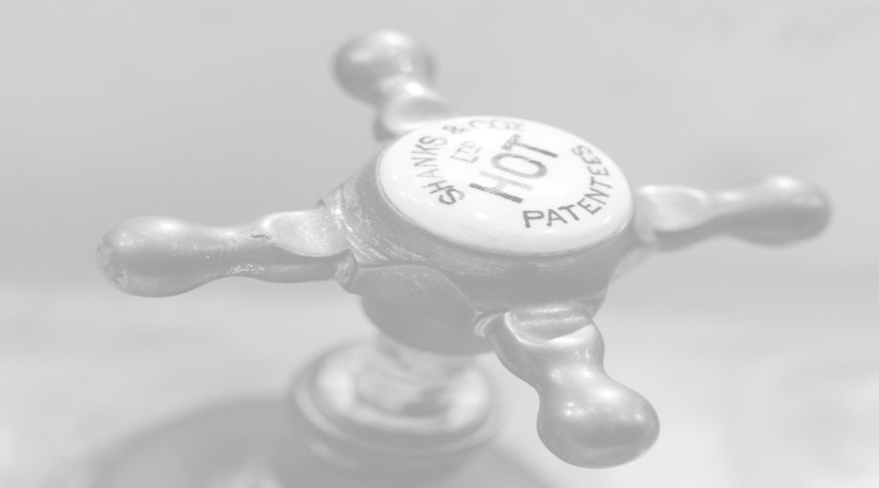
KEY CONSIDERATIONS
Safety
Less awareness of basic dangers
Bathrooms must be made safe and comfortable
Increased risk of falls
Familiarity
Adaptations can be distressing
Bathroom adaptations should be made as soon as possible after diagnosis
Give them time to familiarise themselves with their new bathroom
Notes:
There are two key things to consider when designing a dementia-friendly bathroom.
The first is safety, as most people living with dementia will over time become less and less aware of basic dangers, such as scalding, trips and falls, even flooding. As architects you need to make the bathroom as safe as possible for people with dementia to use, and comfortable too, as this will reduce the likelihood of them becoming distressed, with increased distress putting them at a higher risk of injury.
The second key consideration is familiarity. As we’ve touched upon already, distressing someone with dementia can lead to a number of negative outcomes; having multiple contractors you’re unfamiliar with in your home, making loud noises for long periods of time, and rendering your bathroom unavailable for most of the day - often for several days - is distressing enough for people without dementia, let alone those with. And for most of us, seeing a shiny new bathroom at the end of it is usually a cause for celebration, but for someone with dementia, while they may have gained a much safer space, it’s one they aren’t familiar with and have to relearn how to use, which can be distressing.
The timing and delivery of an adaptation is really important because you want to minimise the amount of distress the person will experience as much as possible – which is why it is recommended that adaptations take place sooner after diagnosis, rather than later, as it allows them more time to familiarise themselves with their new bathroom, before their symptoms worsen.

Slide 8
DESIGN CONSIDERATIONS
1. Protection against scalding and burns
2. Minimising the risk of and consequences of falls
3. General confusion
4. Short-term memory loss
5. Retro memory
6. Floor colour perception
7. Visual confusion
Notes:
When it comes to designing a dementia-friendly bathroom there are seven considerations to bear in mind, as these will help you to create a space that is safe and comfortable for someone living with dementia to use.
These are:
1. Protection against scalding and burns
2. Minimising the consequences of falls
3. Short-term memory loss
4. Retro memory
5. General confusion
6. Floor colour perception
7. Visual confusion

Slide 9
1. PROTECTION AGAINST SCALDING & BURNS
Potential Hazards:
Taps, mixer shower valves, radiators and exposed pipes that are hot-to-touch
Non-thermostatic taps and showers that do not safely regulate the temperature
Design Solutions:
Choose taps and/or shower controls with thermostatic protection
Install LST (low surface temperature) towel rails or underfloor heating instead of radiators
Don’t leave any potentially hot pipework exposed
If using a mixer shower, ensure it features a cool-touch valve, or install an electric shower
Notes:
One of the biggest dangers to people with dementia is their perception of hazards as this progressively decreases over time and means they’re more susceptible to scalding and burns.
People with dementia may forget that taps, mixer shower valves, radiators or exposed pipes in their bathroom are sometimes hot-to-touch and this can give them a shock - if they also struggle with their mobility, this can be especially dangerous if they try to use these fixtures to support or steady themselves in the event of a trip or fall.
Unregulated water temperature can also be a safety issue, for example, if you or I were in the shower and experienced a sudden temperature change due to another tap in the house being used at the same time, we would instinctively move out of the stream or adapt the flow to prevent ourselves from being scalded. People with dementia may not have that instinct and could end up being hurt.
There are several design solutions to help reduce the risk of scalds and burns when designing a dementia-friendly bathroom.
Firstly, you can install thermostatic taps and/or showers; these ensure the water temperature remains constant, so there's no risk of scalding or being shocked by a sudden temperature change.
You can opt for low surface temperature towel rails or underfloor heating as an alternative to traditional radiators.
All pipework, where possible, should be boxed in, and finally, if a mixer shower is being installed, then you should choose one with a cool-touch valve, or go for an electric shower instead.

Slide 10
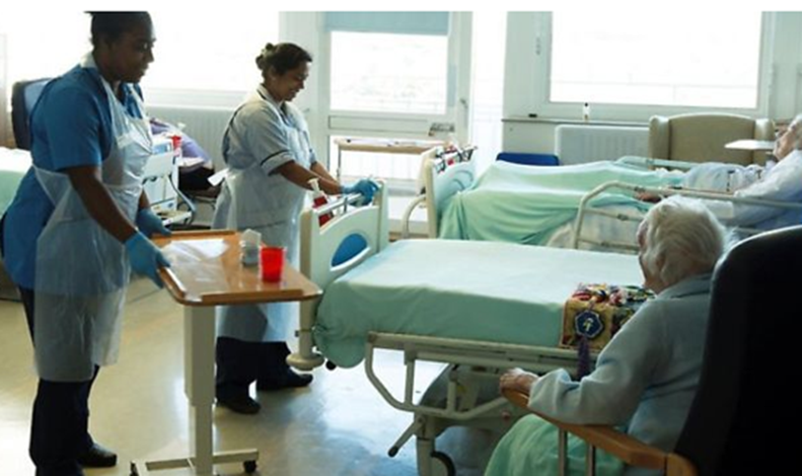
2. MINIMISING THE CONSEQUENCES OF FALLS
“People with dementia are twice as likely to fall as others in their age group and are three times more likely to be dead within three months as a result.”
PROFESSOR MARY MARSHALL, DEMENTIA SERVICES DEVELOPMENT CENTRE, UNIVERSITY OF STIRLING
Notes:
Falls in the bathroom are incredibly common among older people; according to the UK Government website, falls are the number one reason for visits to A&E for this demographic, with unaddressed trip hazards in homes costing the NHS approximately £435 million. (Source: https://www.gov.uk/government/publications/falls-applying-all-our-health/falls-applying-all-our-health)
Unfortunately, this risk of trips and falls drastically increases for people with dementia, who are twice as likely to fall as others in their age group, and three times more likely to pass away within three months as a direct result.

Slide 11
2. MINIMISING THE CONSEQUENCES OF FALLS
Potential Hazards:
Uneven or slippery floors and surfaces
Baths or step-in showers
Protruding sharp edges
Radiators, floor-standing or low-level furniture/fixtures
Glass shower screens
Notes:
In a bathroom, there are a whole host of potential trip hazards. The primary risks are uneven or slippery floors and surfaces, and baths or step-in showers. Even if these issues are addressed in an adaptation, it’s important to note that there are other things in the bathroom that can make the consequences of a fall even worse, which we should also take into consideration.
For example, protruding sharp edges have the potential to do a lot of damage if someone hits them while tripping or falling. The same can be said for radiators, pieces of floor-standing or low-level furniture such as storage units, and even glass shower screens.

Slide 12
2. MINIMISING THE CONSEQUENCES OF FALLS
Design Solutions:
Level-access throughout with slip-resistant flooring
Ensure there are no sharp edges
Install underfloor heating instead of radiators
Minimise use of floor-standing or low-height units/fixtures
Choose shower curtains that hover above the floor and are made with breathable fabric
Opt for PET (tough plastic) shower screens rather than glass
Include a shower seat and grabs rails in the specification
Consider two-way door hinges which allow access if the client falls against the door or screen
(Note: don’t reverse hinges to only open outwards as that could cause confusion/upset)
Notes:
Given this, there are several things you can consider when designing a dementia-friendly bathroom that can help to minimise the consequences of falls.
The most obvious is to make sure the bathroom floor and showering area offers safe, level access and is finished with slip-resistant flooring – ideally vinyl. Non-slip flooring will also reduce the need for bath mats which can be a trip hazard.
You should ensure there are no sharp edges that people could hurt themselves on when falling and install underfloor heating instead of radiators. You should also minimise the use of floor-standing or low-height units or fixtures as much as possible, opting for wall-mounted shelves with easier access instead.
If the bathroom features shower curtains, you should make sure these are made with breathable fabric, because if someone should fall and become entangled, there will be less risk of suffocation.
Instead of glass shower screens you can opt for tough PET plastic which offers greater durability in an environment with an increased risk of falls. We also recommend including a shower seat and a shower with a riser rail that acts as a grab rail in the specification, this is so the client can sit down or has something close by to help stable themselves when showering.
You should also consider doors and screens with two-way hinges which allow access if the person falls against it; but it’s important to note that you shouldn’t reverse hinges to only open outwards, as that could cause unnecessary confusion or upset if the person struggles to operate the door.

Slide 13
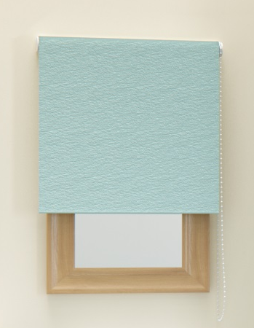
3. GENERAL CONFUSION
Potential Hazards:
Mirrors
Reflective surfaces
Excessive light from windows
Design Solutions:
Reversible or coverable mirrors
Frosted shower screens
Use matt, not satin or gloss finish tiles or wall panels
Blinds over windows
Notes:
Sadly, a small percentage of people with dementia don’t recognise their own reflection, so if they come across themselves in a mirror, or reflective surface, they may think someone else is in their bathroom which could lead to confusion or even fear or reluctance to use the bathroom.
To help alleviate this risk, you should consider a mirror that can be easily reversed or covered – roller blinds are a common solution in these cases.
You should also try to find alternatives for reflective surfaces where possible. For instance, instead of using clear PET in shower screens, a frosted finish would be better, and we strongly advise against using shiny tiles or glossy wall panels, opting instead for wall surfaces with a matt finish.
If there is a window in the bathroom, you should ensure that daylight can be controlled using a blind to help minimise the glare and shadow contrasts in bright sunlight, as this too can add to confusion for people with dementia.

Slide 14
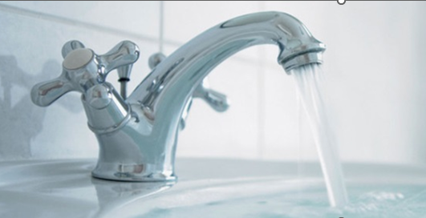
4. SHORT-TERM MEMORY LOSS
Potential Hazards:
Forgetting to turn off showers or taps when running
Design Solutions:
Showers with automatic shutdown settings
Use flood-proof plugs, or alternatively, don’t install a plug at all
Notes:
Short-term memory loss can be dangerous in the bathroom especially when water is concerned, as someone living with dementia may forget what they’re doing while preparing to do something or indeed while carrying out the activity, such as brushing their teeth, washing their hands, or grooming. This means they may forget to turn off the taps or shower and unintentionally leave them running.
To help with this, we would recommend installing a shower with an automatic shutdown setting which turns the water off once a pre-determined time has elapsed – for example, 30 minutes. For the sink, flood-proof plugs are a good option as they release the water once it reaches a certain level, or if it’s left unattended for a period of time. Alternatively, you can always choose not to install a plug at all.

Slide 15
5. RETRO MEMORY
Potential Hazards:
Unfamiliar, modern designs of sanitaryware and taps
Impractical, shallow wash basins
Complicated shower controls or features
Design Solutions:
Choose familiar looking and feeling products that are easier to recognise and use – traditional tap handles, lever toilet flushes etc
Select deep wash basins with a large tap deck
Avoid overhead rainfall style shower heads that can be overwhelming
Notes:
Many people with dementia may have trouble recalling recent events but are still be able to remember older memories; which is why ensuring the bathroom is as easy to use and familiar as possible is crucial.
Unfamiliar and modern pieces of sanitaryware can be confusing, for instance, concealed cisterns or square toilets or sinks could be confusing for someone who is expecting a traditional cistern or rounded bowl. The same can be said for mixer taps, shallow sinks, and showers with overly complicated controls or features, all of which could cause unnecessary distress for someone who doesn’t recognise it or cannot use it in the same way they remember from the past.
Therefore, choosing familiar looking and feeling products that are easier to recognise and remember the operation of is really important. Examples of these include choosing taps with traditional looking handles – ideally separate hot and cold taps with red and blue temperature indicators on them – and lever toilet flushes rather than sensors or buttons as these can be confusing.
You should make sure the sink is deep enough for them to carry out personal grooming and has a wide enough tap deck to accommodate items like a toothbrush mug, toothpaste and soap, so this is within easy reach.
It’s important to add that the position of the toilet is crucial, as this is best placed within clear sight of the door – and in a nursing home environment, the toilet should be seen from the bed.
Overhead rainfall style shower heads or showers with jets or steam functions should also be avoided as these can be incredibly overwhelming for someone with dementia. Showers with simple, clear controls and settings are highly recommended for installation in dementia-friendly bathrooms.

Slide 16
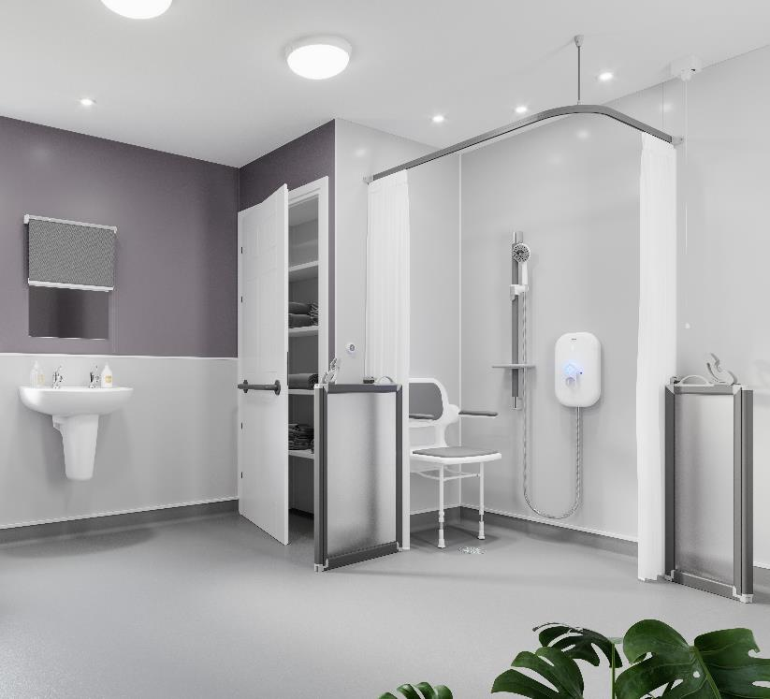
6. FLOOR COLOUR PERCEPTION
Potential Hazards:
Use of multiple flooring colours or types
Misperception of floor depth, dryness, or state of cleanliness
Design Solutions:
Ensure the floor is a single colour throughout
Avoid dark colour flooring
Avoid flooring with a shiny or reflective finish
Avoid designs with large flecks
Colour-matched shower waste cover
Notes:
As we previously highlighted, the perception of risk is often different for someone living with dementia, and this is especially challenging when it comes to flooring.
Changes in floor colour – either in one room or between adjoining rooms or corridors – can lead someone with dementia to believe there is a step up or down, which can cause them to trip or fall when attempting to avoid the perceived risk. The same is also applicable with dark coloured flooring which can be mistaken for a large hole and could make someone reluctant or scared to enter the bathroom; additionally, with shiny or reflective flooring, this may appear to be wet to someone with dementia.
When considering the flooring in a dementia-friendly bathroom, you should always ensure the floor is a single colour throughout. We even recommend you avoid using level-access shower trays as someone with dementia may assume the change in colour from floor to tray means there is a step up or down. The safest solution is a wet room that is floored consistently in one colour.
You should avoid very dark coloured flooring which could be perceived as a hole, or something shiny with any sort of reflective finish that can be perceived as being wet, and we recommend you avoid flecked or small patterned flooring as the pattern could be mistaken for dirt flecks, which someone with dementia may try and pick up, leading to the increased risk of them falling and hurting themselves.
We also recommend specifying a waste cover in the shower area that matches the colour and tone of the flooring as closely as possible. For instance, a white waste cover on a grey floor could be mistaken for a bar of soap which could cause falls and injury if the person tries to pick it up.

Slide 17
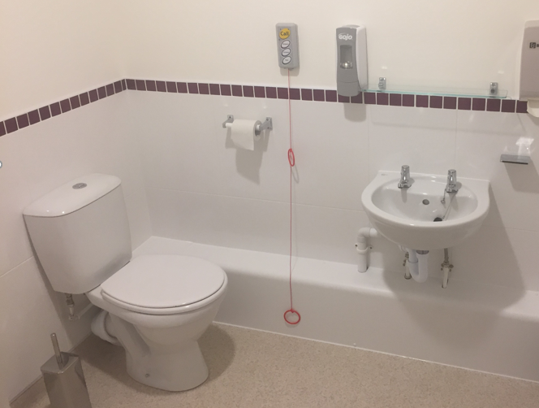

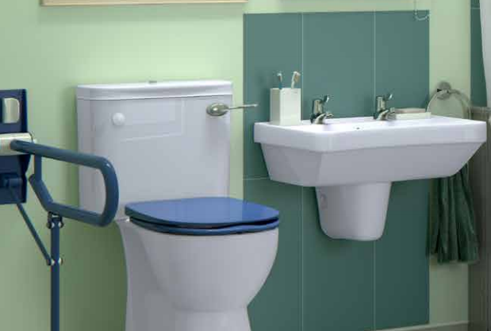
7. VISUAL CONFUSION
Potential Hazard: Difficulty locating and using bathroom items
Design Solution: Big colour contrast
Use colour contrast to differentiate:
- Walls from floors
- Shower curtains and seats from walls
- Toilet pan and seat from other areas
- Toilet roll holder and grab rails from the wall
Use of strongly contrasting colours is more important than the use of specific colours, e.g. red
Ensure 30 points of LRV difference
Notes:
People living with dementia can become distressed if they find it difficult to locate or use the items within the bathroom. One of the easiest ways to make the space less visually confusing is to use strong contrasting colours to clearly define the relevant areas of the bathroom, such as the showering and toilet areas, so the person can safely and effectively find and use them.
There are several things to consider when designing a space that achieves effective colour contrast for someone with dementia:
1. The walls need to differentiate from the floor so they can clearly see where one begins and the other ends
2. The shower curtain and seat need to be a different, clearly contrasting, plain colour to the wall behind it, to make it easy for someone to find the showering area
3. The sanitary fittings need to contrast clearly with the colour of the wall behind
4. The colour of the toilet seat also needs to contrast clearly with the colour of the toilet pan and cistern
5. Toilet roll holders and grab rails need to feature strongly contrasting colours compared to the walls they are fixed to
6. The bathroom door should contrast from the walls on both sides, as well as the floor, with the handle contrasting from the door by a minimum of 15 points LRV
7. All light switches should also feature colour contrast to make them easier to find
Please note that the use of strongly contrasting colours is more important than the use of specific colours, such as red, which was previously thought to be the ‘only ideal’ colour for dementia-friendly spaces. Leading specialists in this area have since advised that this is a misconception, and while red is acceptable, other colours are just as effective, such as dark grey, royal or navy blue, as long as they provide the necessary colour contrast.
In order to achieve a good colour contrast, the Light Reflectance Value (LRV) of all the items in the bathroom needs to be established; this is a measurement of how much light a surface reflects, with 30 points of difference being the ideal amount of difference between surfaces.

Slide 18
7. VISUAL CONFUSION
Potential Hazard: Difficulty locating and using items in the bathroom
Design Solution: Task-Focused Lighting
Highlights key areas in the bathroom so they stand out:
- The toilet
- The sink
- Shower controls
- Shower seat
Extra light aids with personal grooming
Enables greater monitoring of health conditions, e.g. diabetes
Notes:
Another way to make it easier for someone with dementia to locate and use the various items in the bathroom is with lighting. Light levels for bathrooms should be around 300 lux during the daytime and lighting within rooms should be uniform to avoid dark spots and shadows.
To help people with dementia find specific task areas, we recommend installing Task-Focused Lighting, which consists of narrow beam spotlights that illuminate key areas in the bathroom to ensure they stand out, such as the toilet, sink, controls on the shower, and the shower seat.
Not only does considerate lighting help people to find key activity areas, but it helps them to clearly see the controls of the items they’re trying to use. It can also aid them with personal grooming such as applying make up and shaving, and allows for greater monitoring of various health conditions; for example, the extra light may help a diabetic with inspecting their feet.

Slide 19
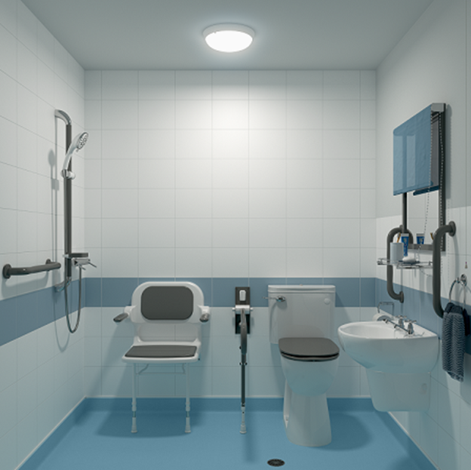
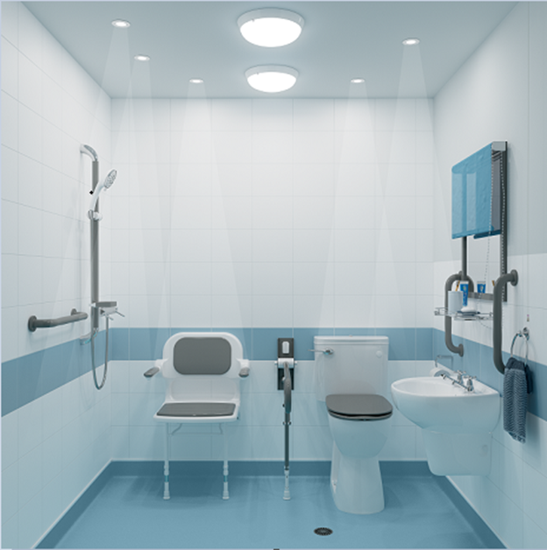
7. VISUAL CONFUSION
Standard Lighting: items blend together, increased shadowing
Task-Focused Lighting: Key items stand out clearly, reduced shadowing
Notes:
Here is a visual example of the difference Task-Focused Lighting can make in a small bathroom space.
As you can see on the left, the bathroom features a single standard LED ceiling light, which results in a large amount of shadowing – something that can be confusing for someone with dementia. The bathroom also lacks the brightness needed to carry out activities as effectively when compared to the image on the right.
The second bathroom benefits from double the amount of light from standard LED ceiling lights which have been positioned in such a way to reduce the shadowing, it also includes several narrow beam task-focused spotlights which have been installed over the sink, toilet, shower seat, and shower unit to make them stand out more.

Slide 20
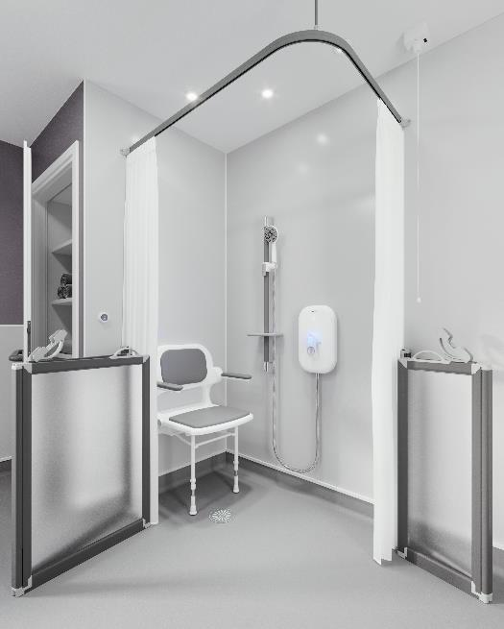
7. VISUAL CONFUSION
Potential Hazards:
Shiny wall coverings and accessories
Patterns on tiles
Design solutions:
Matt-finish wall panels or tiles with a slight bumpy surface can help reduce glare
Plain coloured tiles with grout as close to the tile colour as possible
Avoid shiny tiles or ones with a 3D representation of objects on them
Notes:
Finally, visual confusion can also be caused by glare from shiny surfaces such as tiles, and by the patterns on tiles or wall panels.
Just like floors, we would recommend the finish used on the walls is plain. If you’re using tiles, then you should avoid patterns and three dimensional representation of objects, and consider choosing a grout colour which matches as closely as possible to the colour of the tiles, as a contrasting grout colour will inadvertently create a pattern.
You should also avoid shiny tiles or wall panels as these can cause issues with reflections – which as we previously highlighted, can lead to distress for people living with dementia. Glare is also problematic as it causes visual discomfort and squinting, and is often misinterpreted with shadows seen as objects and holes.

Slide 21
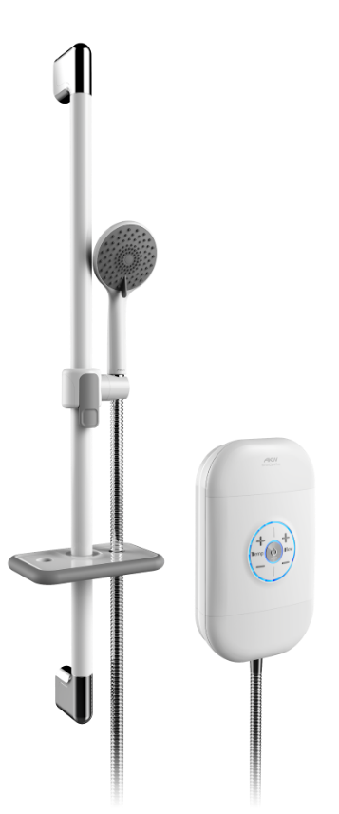
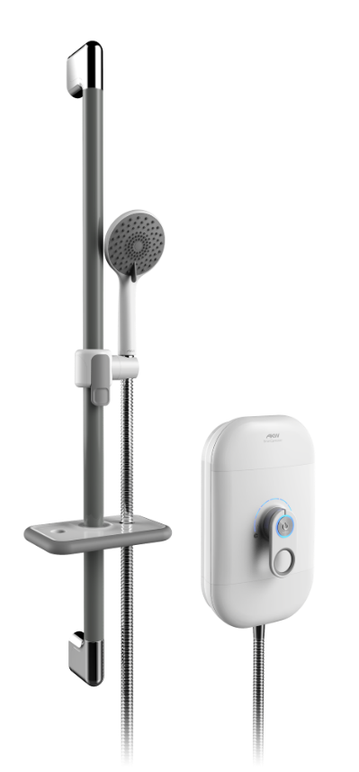
DEMENTIA-FRIENDLY SOLUTIONS
AKW SmartCare Electric Showers
As of 2024, both new generation AKW SmartCare electric showers are DSDC dementia-friendly product accredited
Controls are clear and simple to use with tactile, colour contrasting elements
Audible clicks/beeps and LED display
Matt-finish central control panel for reduced glare
Care accessory kit comes with contrasting riser rail offered in multiple colours
Notes:
At AKW, we’ve designed a number of practical, inclusive solutions to help with designing and specifying a dementia-friendly bathroom; the first is our range of electric care showers.
Back in 2021, the AKW SmartCare Lever became the first electric shower to be awarded dementia-friendly product accreditation by the experts at the DSDC. In 2024, when we launched our refreshed range of electric showers, both the SmartCare Lever, and the SmartCare Plus were awarded DSDC accreditation thanks to the design improvements made by our team of engineers.
There are several features that help to make these showers suitable for dementia-friendly bathrooms:
The controls on the heater units are designed to be clear and simple to use, with no unnecessary or confusing settings or features
The symbols letters on the unit controls are raised and tactile, and most importantly, offer colour contrast
Each time a temperature or flow setting is adjusted, not only does the LED display visually advise this, but there’s also an audible beep or click to offer additional confirmation
The central control panel of the shower units feature a matt, non-shiny or reflective finish to help reduce glare
A care accessory kit is available which includes a grab riser rail that offers support for up to 23.5st/150kg
This rail is also offered in multiple colours – including white, mid-grey and navy blue, to help offer colour contrast when needed against the wall surface
There are also colour contrasting elements on various parts of the shower kit, such as the adjustable shelf and handset holder

Slide 22



DEMENTIA-FRIENDLY SOLUTIONS
Matt-Finish Wall Panels:
Single colour panels with no pattern and a matt finish that vastly reduces glare
Light yet warm panel colours helps to create contrast against accessories without appearing too clinical
Easy to keep clean with fewer joins and dirt traps
Super White Bumpy Tiles:
Bumpy tile surface helps to reduce glare and offers high contrast against accessories
Irish Cream
Warm Grey
Notes:
As we discussed earlier, reducing glare in a dementia-friendly bathroom is really important, which is why we offer several solutions to help combat this.
The first are matt-finish wall panels which can be found as part of our Origins Wall Panels collection:
These panels are not shiny or reflective, and do not feature a pattern that could cause confusion for someone living with dementia
They’re available in two warm, muted colours – Irish Cream and Warm Grey – which not only allows them to complement a range of colour schemes without appearing clinical, but they’re also light enough so that colour contrast can be easily achieved
They’re also super easy to keep clean as the panels can be supplied in large sheets, reducing the areas bacteria can thrive with fewer joins and dirt traps compared to tiles
Our Super White Bumpy Tiles are also an option as their bright white colour helps to lighten up the bathroom, however, their bumpy surface helps to deflect and therefore reduce the glare when artificial or natural light bounces off the surface.

Slide 23
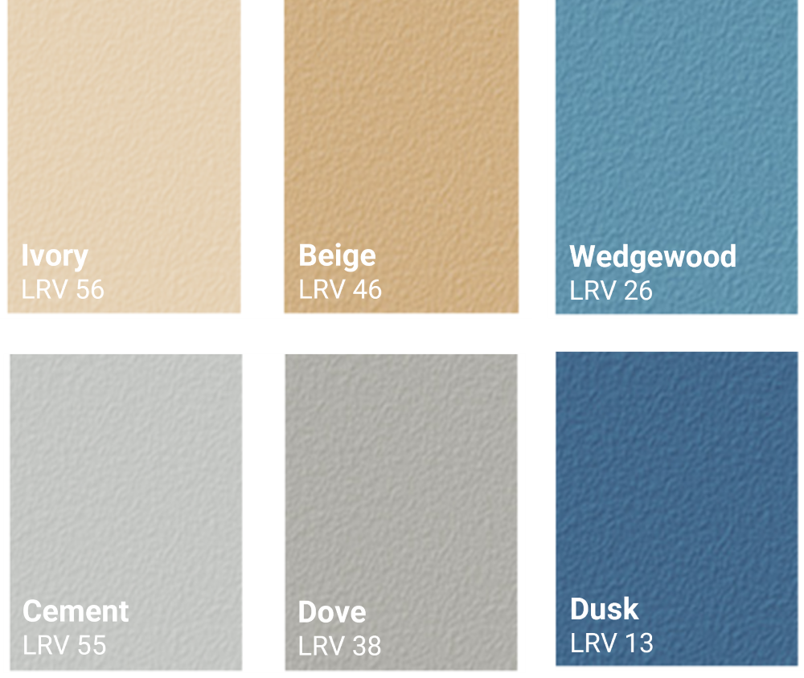
DEMENTIA-FRIENDLY SOLUTIONS
AKW Safety Flooring
All six colours are DSDC dementia-friendly accredited, receiving highest grade (1a)
No pattern or flecks to reduce confusion
Highest barefoot slip-resistance rating when tested in wet and soapy conditions (Class C: DN51097)
Warm, homely traditional colour pallet, not institutional
Notes:
We’re incredibly lucky to offer our own range of dementia-friendly vinyl safety flooring, which like our electric care showers, has also been awarded dementia-friendly product accreditation from the DSDC.
All six colours received the highest grading of 1A meaning they’re ideal for installation in dementia-friendly bathroom spaces, with the range of warm and homely colours designed to help offer the appropriate level of colour contrast against sanitaryware.
There is no pattern or flecks which is designed to help reduce confusion for people living with dementia.
The slip resistance of our flooring is also very high when tested in wet and soapy conditions, something it achieves without the surface of the flooring being so abrasive that it damages delicate skin.

Slide 24
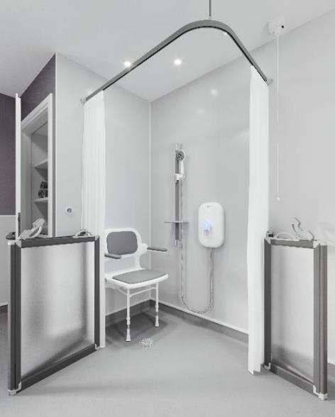
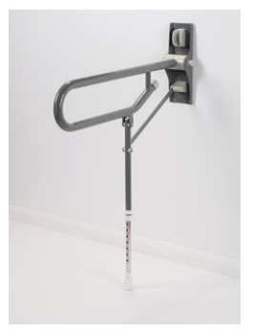
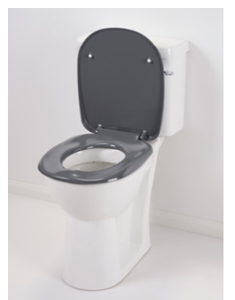
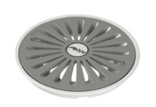
DEMENTIA-FRIENDLY SOLUTIONS
Accessories with High Colour Contrast:
Care screens and curtain rails with colour contrasting elements to help them to stand out
Ergonomic toilet seats, grab rails, and shower seats with contrasting cushions and arms
Mid-grey waste cover for vinyl covered wet room floors helps to reduce confusion that could be caused by the contrast/reflection from a white/chrome cover
Notes:
We’re lucky to offer a broad range of accessories that offer colour contrast, ideal for dementia-friendly bathrooms:
Our range of care shower screens are offered in white or silver grey and come with colour contrasting handles and latches; curtain rails are also offered in both white or grey
Our ergonomic toilet seats are available in blue, mid-grey and navy blue to help offer colour contrast against sanitaryware, walls and flooring
2000 Series Seats are white as standard but offered with blue, light grey, mid-grey, and navy arms and padded seat cushions to highlight these key areas
Our epoxy coated grab rails are also offered in blue, mid-grey and navy to ensure sufficient contrast against walls
Additionally, we also offer a mid-grey waste cover for Tuff Form wet room formers finished with safety flooring; the idea is that this can be used with grey floors to help the waste blend into the floor, rather than draw attention to it like a white cover, or even reflect glare like a chrome cover could – both of which could increase the fall risk of someone living with dementia

Slide 25
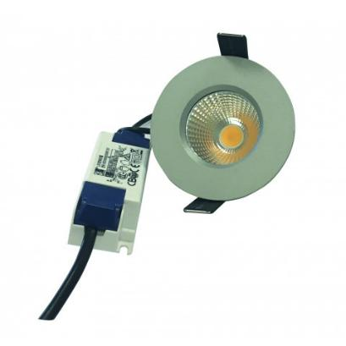
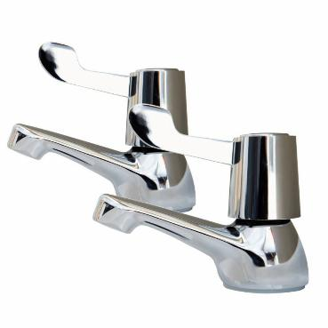
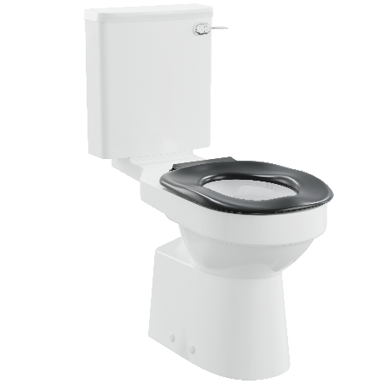
DEMENTIA-FRIENDLY SOLUTIONS
Other Dementia-Friendly Solutions:
Task-Focused Lighting Kit to highlight key activity areas in the bathroom
Lever handle taps which are easy to use with familiar red and blue temperature indicators
Lever handle cistern flush for ease of use and familiarity
SureStop stopcock
Notes:
Finally, we also offer our own Task Focused Lighting Kit which includes two large LED lights to brighten the whole bathroom, along with three narrow beam downlights to help highlight key task areas of the bathroom, such as the toilet, sink and showering area.
Our range of lever handle taps feature red/blue temperature indicators on the top of the tap head, as well as extended lever handles that are easy to use and familiar, with a lever handle flush mechanism also available for our range of cisterns, again to increase familiarity within the bathroom and make the flush easier to operate.

Slide 26
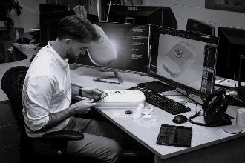
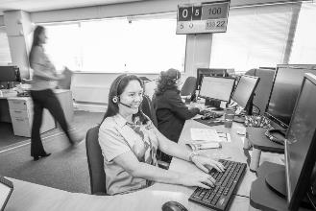
LIFE MADE BETTER
From a small Worcestershire business, AKW has grown into a market-leading international operation:
200+ UK-based colleagues
Over 1 million satisfied customers
World-class manufacturing facilities
Dedicated 30+ vehicle fleet providing door-to-door service
3 national distribution warehouses covering over 3.5m sq. feet
60+ sales and surveying experts nationwide
Notes:
Just a little bit of information now about the team at AKW, for those of you who aren’t as familiar with who we are and what we do.
We are the UK market leaders in accessible bathroom and kitchen solutions, with a portfolio of over 5,500 products designed by our in-house engineers to help you create inclusive, practical, yet beautiful spaces that make life better for people living with reduced mobility, dementia, or visual impairment.
Over the last forty years, AKW has grown from a small business in Worcestershire to a market-leading international operation:
We’ve more than 200 UK-based colleagues, with another 90 elsewhere in the Group which make up our Isle of Man-based engineering department, and our European business who operate on the French and Belgian border and supply countries across the EU
We’re very proud to have served over 1 million satisfied customers in our time
We’re extremely fortunate to have world-class manufacturing facilities, both in the UK and on the Isle of Man
Through our partnership with XPO Logistics, we have a dedicated fleet of more than 30 vehicles providing door-to-door delivery service
We have 3 national distribution warehouses covering over 3.5 million sq. feet
And our nationwide team of sales and surveying experts total over 60

Slide 27
OUR STORY
1982 | Founded by Anthony Keith Webb in Worcester, UK
1996 | Began manufacturing accessible kitchens
2002 | Launched own range of grab rails and shower seats
2014 | Released dementia-friendly bathroom design guide
2015 | Introduced AKW electric showers and wet room formers
2022 | Contour Showers Ltd acquired
2024 | Opened manufacturing facility, showroom and distribution centre in Middlewich, UK
Notes:
A few key dates that help to explain where we’ve come from:
Back in 1982, AKW was founded by Anthony Keith Webb in Worcester. The story goes that Anthony got into the business when he designed his own level-access shower tray for his mother, after finding it difficult to locate a suitable product for her needs on the market.
In 1996 we began manufacturing accessible kitchens in Dudley; production moved to the Isle of Man in 2010, and in 2025 we moved this back to our site in Middlewich, Cheshire.
In 2002 AKW launched their own range of grab rails and shower seats; and our 4000 Series Shower seat is the most-widely specified shower seat in the UK care market.
In 2014 we released our first edition of the AKW dementia-friendly bathroom design guide, which we updated with the support of the DSDC at the University of Stirling for publication in 2025.
2015 saw us introduce AKW electric showers and wet room formers, two key components in the creation of accessible bathrooms. The AKW SmartCare Lever Electric Shower is our most popular model of care shower, it’s also dementia-friendly product accredited by the DSDC – along with the AKW SmartCare Plus – and was the first electric shower in the UK to receive that accreditation.
In 2022, AKW Holdings Group our parent company acquired Contour Showers Ltd which enabled us to further grow within our industry, and lead to the building of Parsons House, our brand-new, purpose-built manufacturing facility, showroom and distribution centre in Middlewich, that opened in 2024.

Slide 28
Notes:
So, what sets AKW apart?
We’re the Industry Innovators - Our portfolio has over 5,500 products designed to offer a one-stop shop solution, with our expert in-house engineers tasked with creating inclusive innovations that make life better for people living with reduced mobility, dementia, or visual impairment.
Our products are Manufactured to Last – We’re experienced manufacturers, and we oversee every stage of the production process from beginning to end, that’s why we’re confident enough to offer the longest warranties in the market and give our customers ultimate peace of mind.
Our designs are Tried & Tested – They’re independently assessed and certified by various third-party organisations, including the RNIB, DSDC and BEAB Care, to ensure they meet the required care and safety standards for our customers.
Our team benefit from a Personable Sales Approach – with our experienced network of Sales Representatives there to offer insightful knowledge and practical advice, on-hand in your local area, when you need it.
We’re lucky to offer a Nationwide Surveying Service that reaches across the length and breadth the UK mainland – with our Surveyors able to conduct on-site visits and provide drawings to design the most effective adaptation for our customers.
We’re Here to Help - Our Customer Services department is comprised of regional advisors trained to deliver market-leading support to our customers.
We Always Prioritise Safety – with our Quality Control colleagues working to ISO standards and rigorously inspecting our products before dispatch.
We have a very reliable Dedicated Transport Network - With stock available from several UK-wide distribution hubs, we’re able to provide next-working-day delivery services in partnership with XPO and DPD, who delivered an impressive 99.16% of orders on time and in full in 2024.
We offer fantastic Aftersales Assistance – You can take advantage of expert aftersales guidance and assistance from our Technical Team who are just at the end of the phone.
And we can deliver On-Site Care & Repair – With our skilled nationwide team of Maintenance Engineers able to offer on-site technical support within 3-working-days, if required.

Slide 29
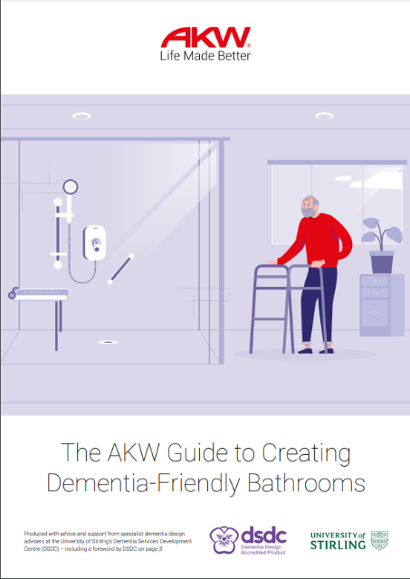
A FINAL THOUGHT
A well-designed dementia-friendly bathroom…
Doesn’t have to cost more than one that isn’t
Doesn’t have to look like a hospital bathroom
But to create a safe, inclusive space that promotes independent living and dignity, we need to make specific and considered decisions when designing and specifying.
Notes:
We just want to share one final thought before we conclude today’s session.
We believe that a well-designed dementia-friendly bathroom doesn’t have to cost more than one that isn’t and doesn’t have to look like a hospital bathroom.
But to create a safe, inclusive space that promotes independent living and dignity, we need to make specific and considered decisions when designing and specifying.
For general information about designing dementia-friendly bathrooms, you can download our guide which has been produced with the team at the Dementia Services Development Centre at the University of Stirling.

Slide 30
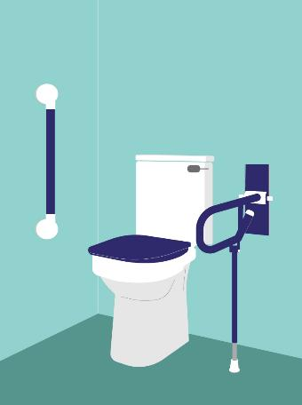

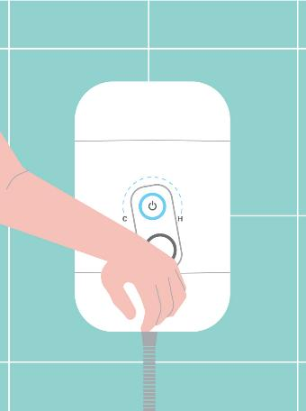
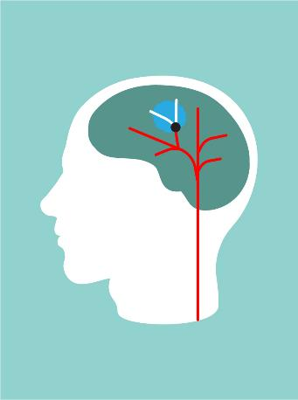
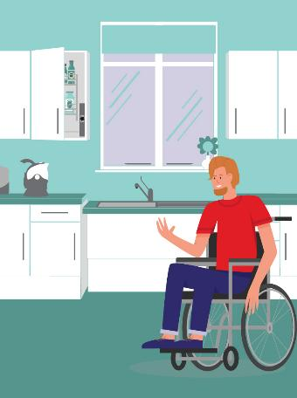
AKW CLINICAL HUB
The AKW Clinical Hub is home to a collection of digital resources designed to offer condition-specific information to support occupational therapists – www.akw-ltd.co.uk/clinical-hub
VISUAL IMPAIRMENT
DEMENTIA
ARTHRITIS
STROKE
WHEELCHAIR ACCESSIBILITY
Notes:
For more product information and best practice design advice on specifying for clients with a range of conditions and care requirements, please visit the AKW Clinical Hub, which is home to a collection of digital resources, including videos and educational guides.

Slide 31
THANK YOU
FOR YOUR TIME
PLEASE FEEL FREE TO ASK US ANY QUESTIONS YOU MAY HAVE.
Notes:
Thank you so much for your time today, I hope this session has been beneficial; if you have any questions, please feel free to ask us.

