Slide 1
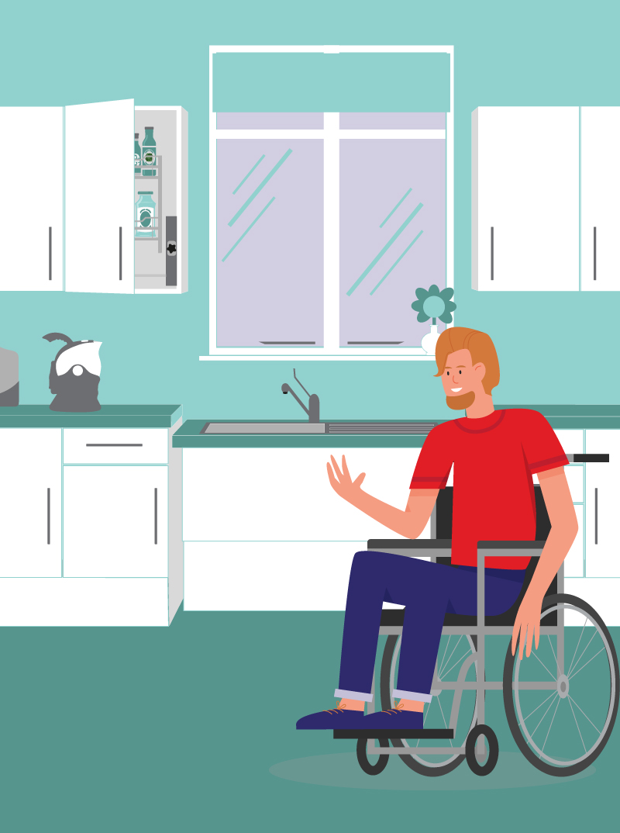
INCLUSIVE DESIGN: WHEELCHAIR ACCESSIBLE BATHROOMS & KITCHENS
CREATING SAFE, ACCESSIBLE SPACES TO SUPPORT INDEPENDENT LIVING

Slide 2
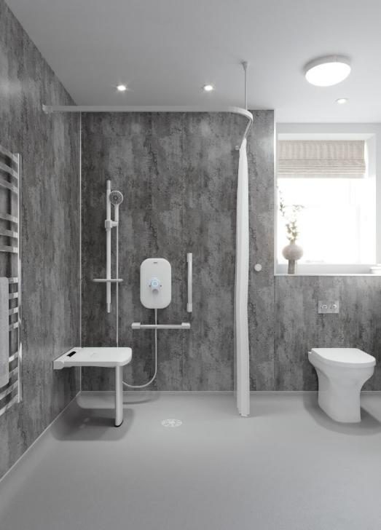
INTRODUCTION
Inclusive design supports independence, dignity and safety
Bathrooms and kitchens are critical to daily living yet often pose the most barriers
Good accessible design eliminates barriers, creating enabling rather than disabling spaces
The goal is to produce spaces where everyone can function, enjoy and control

Slide 3
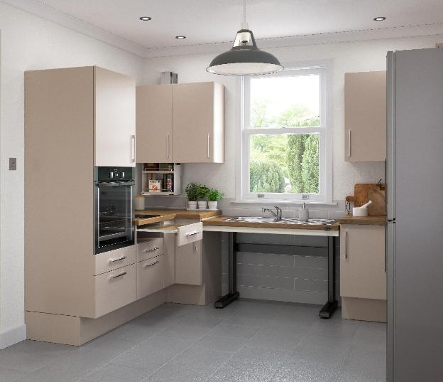
KEY STATISTICS
There are an estimated 1.2 million wheelchair users in the UK
Approximately 1:3 are described as ‘ambulatory wheelchair users’
In the 2021-22 period (last large scale NHS data collection) 586,000 people were registered with NHS wheelchair services
Of those, 90% were adults, 10% were children

Slide 4
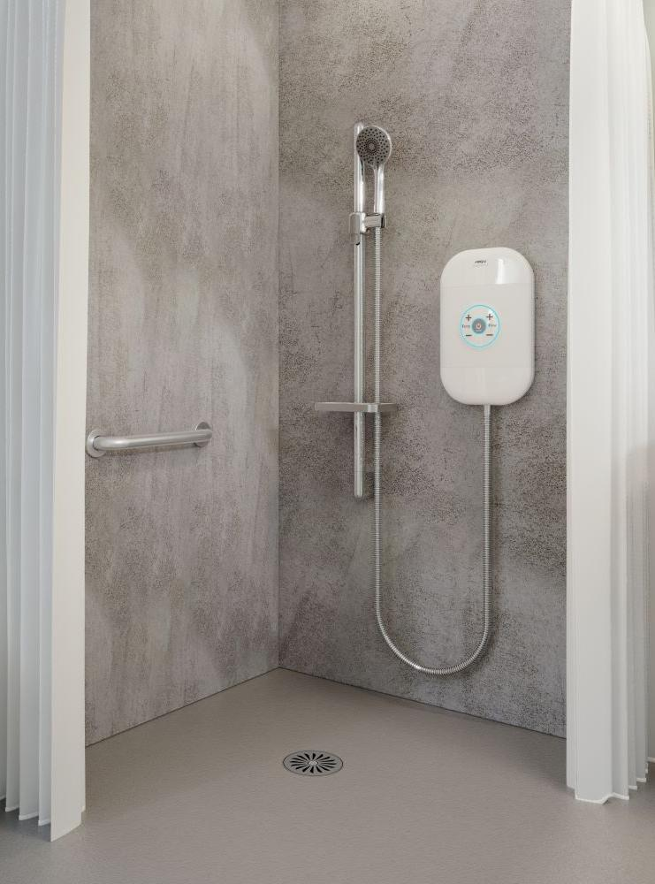
WHEELCHAIR ACCESSIBLE BATHROOMS
WHAT DOES ‘GOOD DESIGN’ MEAN?

Slide 5
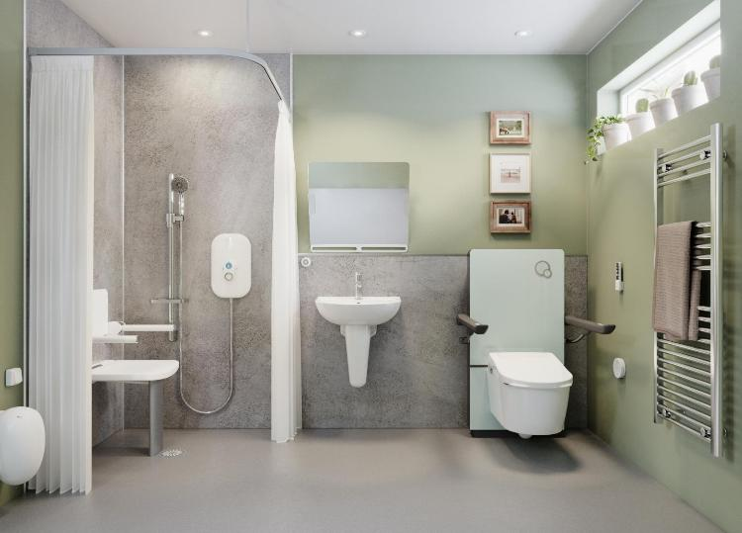
Although all accessible bathrooms should be tailored to the individual’s needs, there are some common design elements to consider when specifying any wheelchair accessible bathroom.

Slide 6
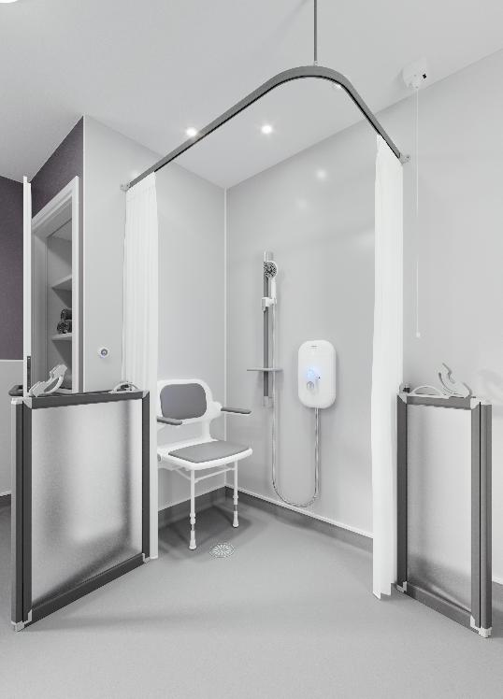
'GOOD DESIGN’ PROMOTES SAFETY
Prioritise level access throughout with a wet room former or a recessed/ramped shower tray
Ensure doors are outward facing or sliding
Minimise gradient at toilet created by water drainage
Consider toilet height and if possible, make it accessible from both sides
No external plumbing
Think carefully about impact of radiators and towel rails on turning circles
Use slip-resistant flooring
Ensure basins have a recess (ideally wall hung) to ensure access

Slide 7
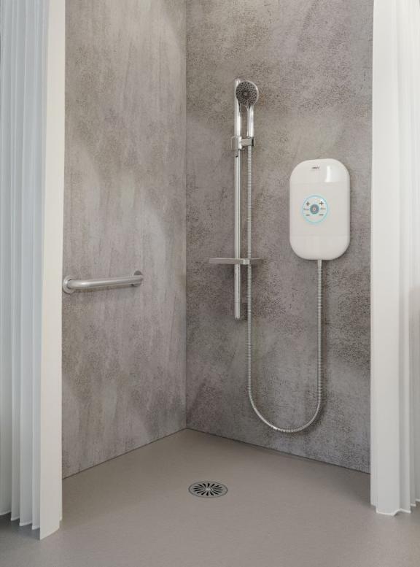
'GOOD DESIGN’ PROMOTES INDEPENDENCE
Shower placement will impact movement around the space
Utilise technology such as the AKW SmartCare Plus Electric Shower
Add handles or rails to the door, enabling the user to close behind them more easily
Consider reach and other anthropometrics when specifying essential fixtures and fittings
Tailor the placement of grab rails
Consider AKW Bidet to maximise independence and dignity

Slide 8
'GOOD DESIGN’ MAKES LIFE BETTER
There’s no ‘one size fits all’ with wheelchair accessible bathroom design, so consider:
Does the wheelchair user have small children in the house?
Removing the bath might impact on roles such as that of parent. Remember, DFG can cover “shower, bath, or both”
Does the wheelchair user have a visual impairment, arthritis or dementia?
Review AKW’s collection of online resources when designing for these groups.

Slide 9
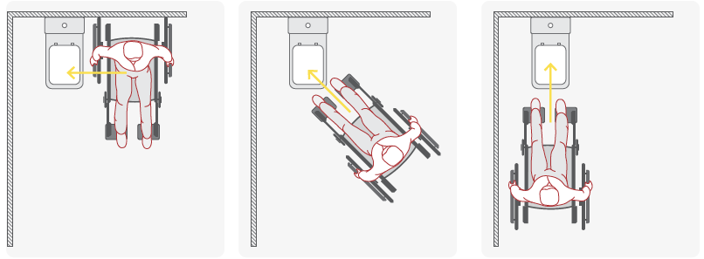
KEY CONSIDERATIONS
TOILET TRANSFERS
It is crucial to allow sufficient space to support the persons transfer.
If space does not allow access to both sides, consider how the design impacts the angles illustrated below:

Slide 10
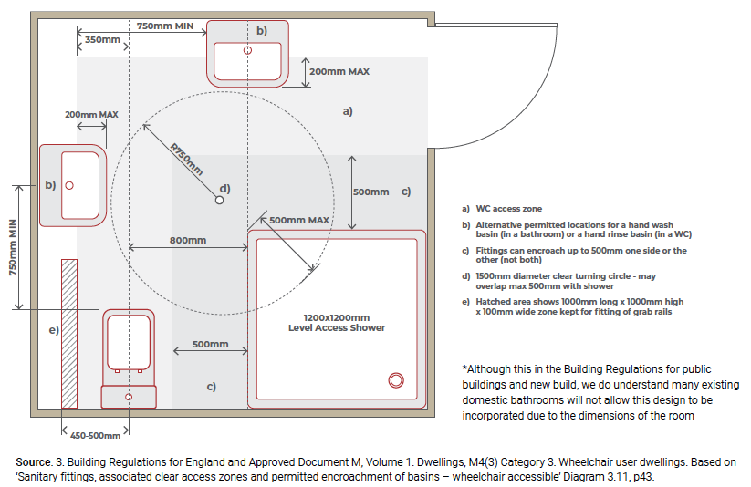
KEY CONSIDERATIONS
LAYOUT - BUILDING REGULATIONS ADM
The image opposite is an example of a compliant bathroom floor plan.
However, consider that the regulations are based on the minimum standard, and that recent research reflects that this remains inadequate for the majority of wheelchair or mobility aid users.

Slide 11
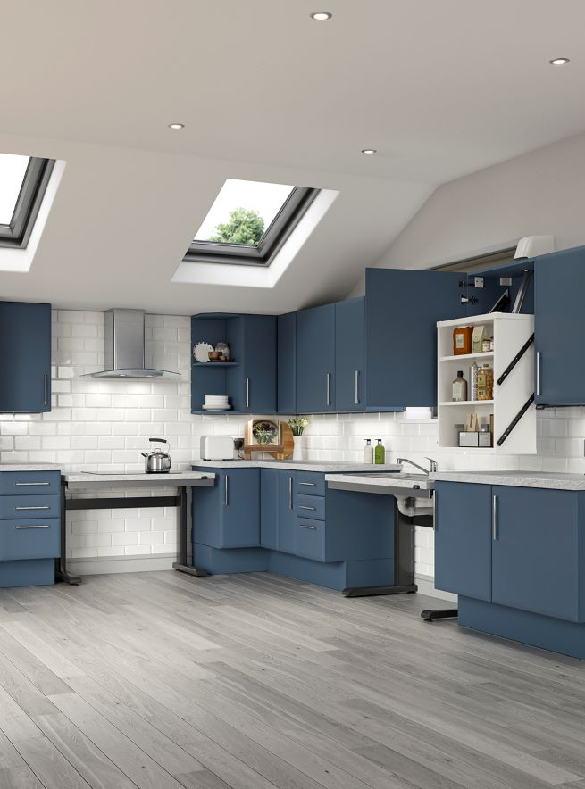
WHEELCHAIR ACCESSIBLE KITCHENS
WHY IS IT SO IMPORTANT?

Slide 12
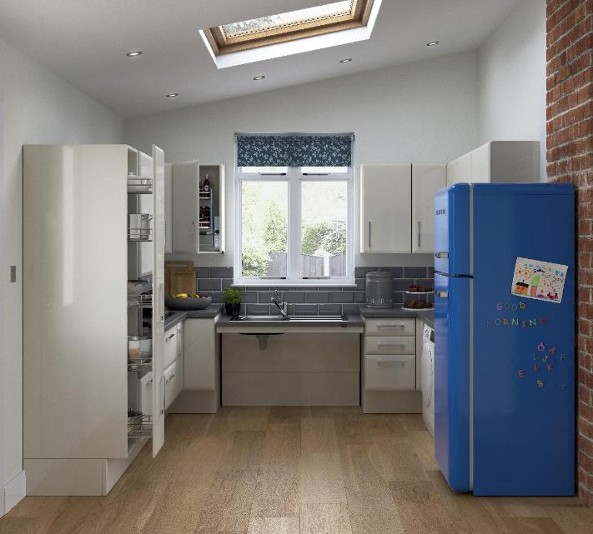
Described as the ‘hub of the home’, the kitchen is often overlooked in prioritisation of other rooms. However, as an integral space for necessary functioning, family contact and social interaction, the kitchen should be given the same importance as the bathroom.

Slide 13
WHEELCHAIR ACCESSIBLE KITCHENS
In a domestic kitchen, it’s important to consider some key questions:
How is the kitchen used by all family members?
Will that use change in the future?
What space is required for thoroughfare and turning circles?
What appliances are necessary?
What type and amount of storage is required?
How much workspace is required?

Slide 14
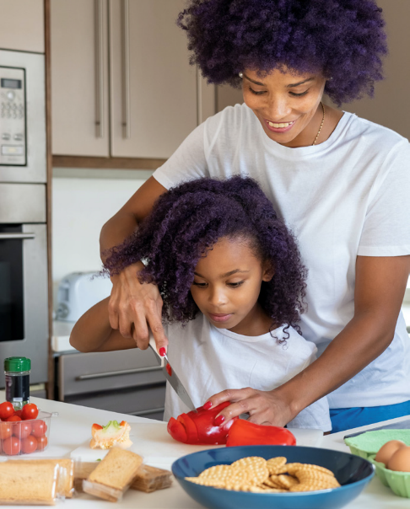
KITCHENS & CHILDREN
Preparing and cooking food is a core skill development from a young age, where children learn through senses.
The design for a child needs to be flexible enough to enable growth in the space whilst continuing to learn and develop.

Slide 15
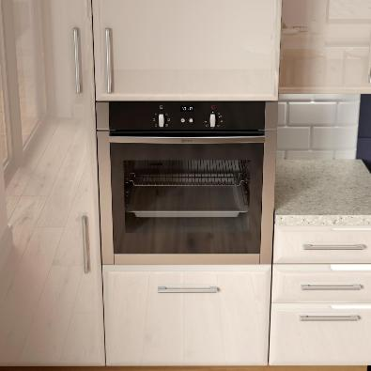
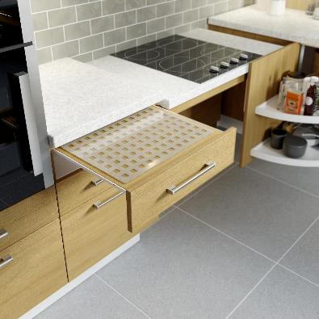
‘GOOD DESIGN’ PROMOTES SAFETY
Never require a wheelchair user to carry pans, plates or other objects on their lap
Never use under bench ovens
Never use ovens with pull-down doors that are not Slide & Hide
Avoid gas hobs

Slide 16
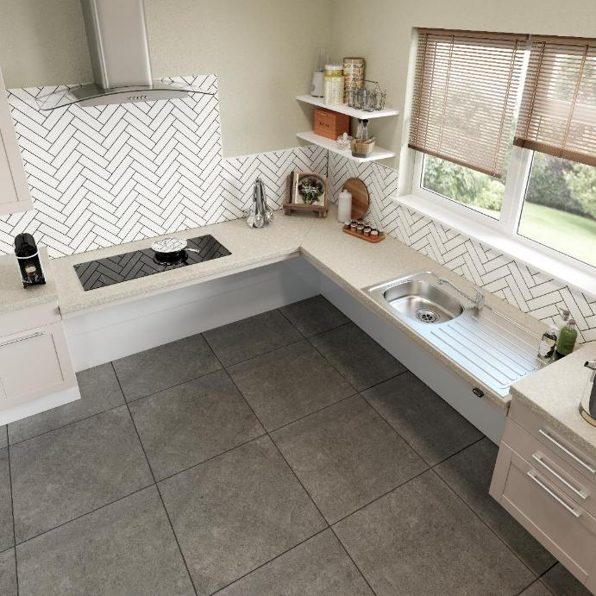
‘GOOD DESIGN’ PROMOTES INDEPENDENCE
Consider whether a fixed or adjustable-height worktop is required; remember the person could be an ambulant wheelchair user whose needs might fluctuate
Ensure fascia and kick boards are sufficiently recessed to allow close access to the worktop
Use an oven fitted into a tall housing unit at a height suitable for the individual; they should also have Slide & Hide or side-opening door and be fitted alongside a heat-resistant pull-out surface where possible.
Consider that microwaves tend to be left-hand hinged
Induction hobs are the most suitable option

Slide 17
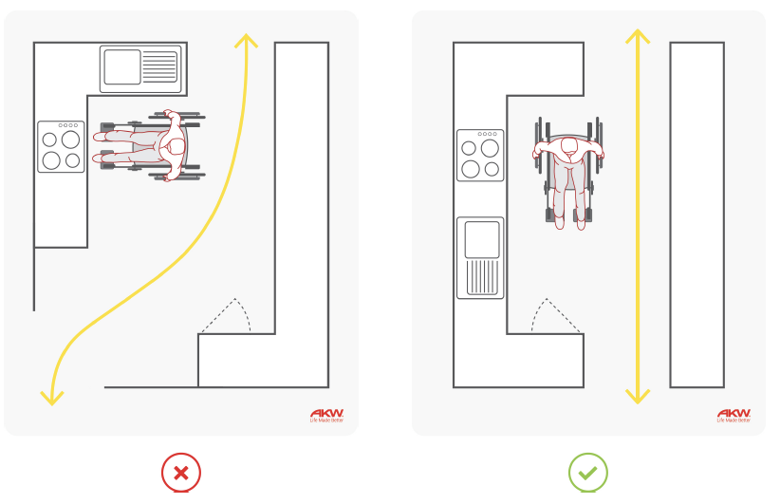
KEY CONSIDERATIONS
LAYOUTS
The layout should be designed to allow for continuous flow with no/limited turning involved as indicated in the illustration opposite.

Slide 18
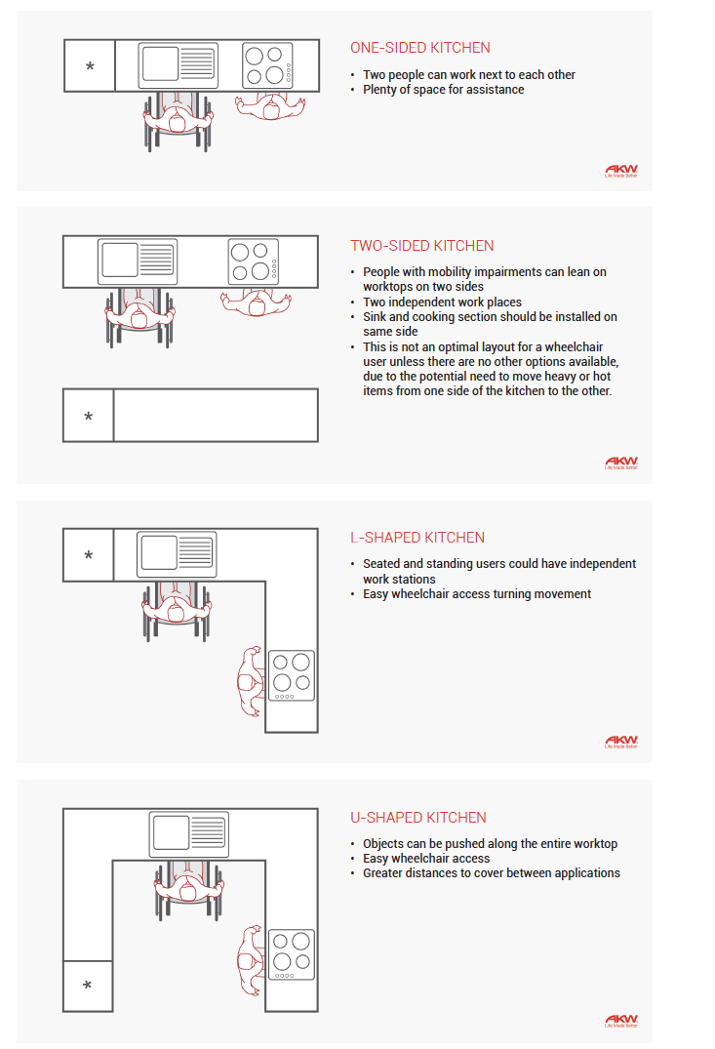
KEY CONSIDERATIONS
COMMON LAYOUT EXAMPLES

Slide 19
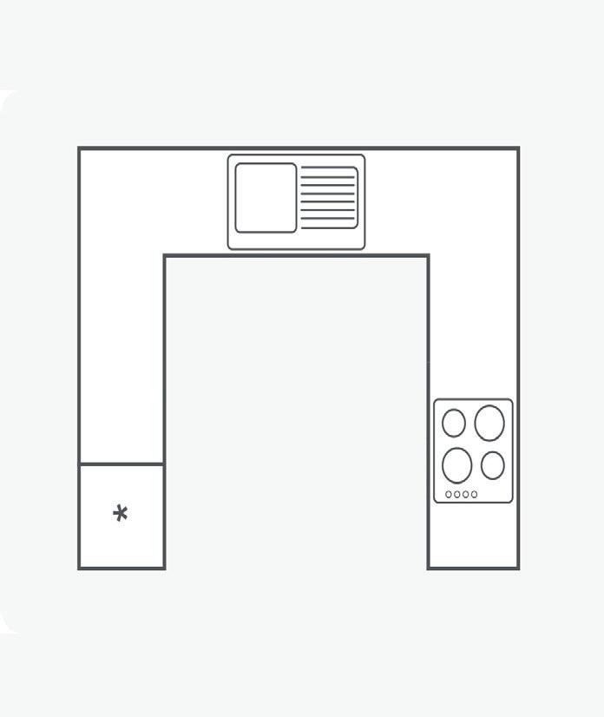
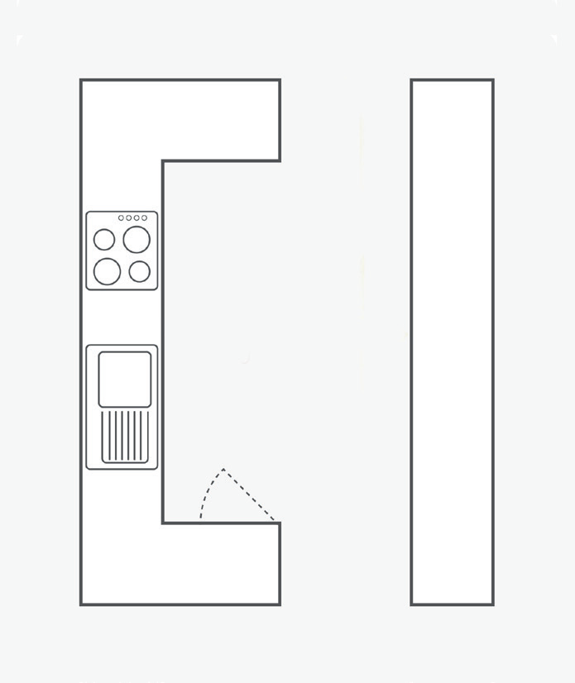
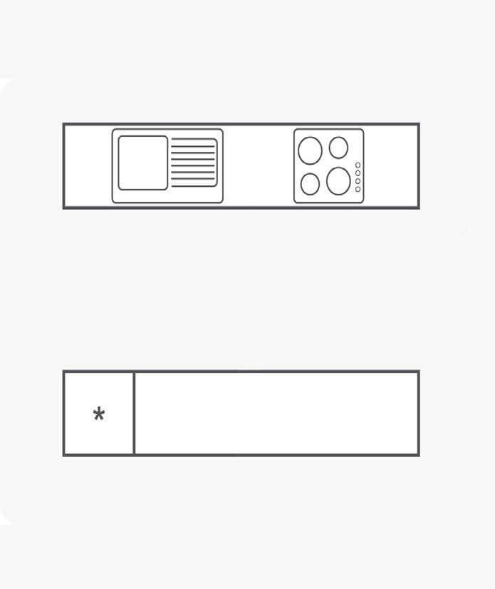
KEY CONSIDERATIONS
CIRCULATION SPACE
The kitchen should have a clear circulation space of 1500 x 1500mm between facing vertical surfaces (wall or cupboard fascia).
Do not forget that raised-height, deep recess plinths (1500mm from front of the cabinet) can be included in the turning area calculations and do significantly increase the turning area as footplates and feet can safely pass under the units.
1500 x 1500
1500 x 1500
1500 x 1500

Slide 20
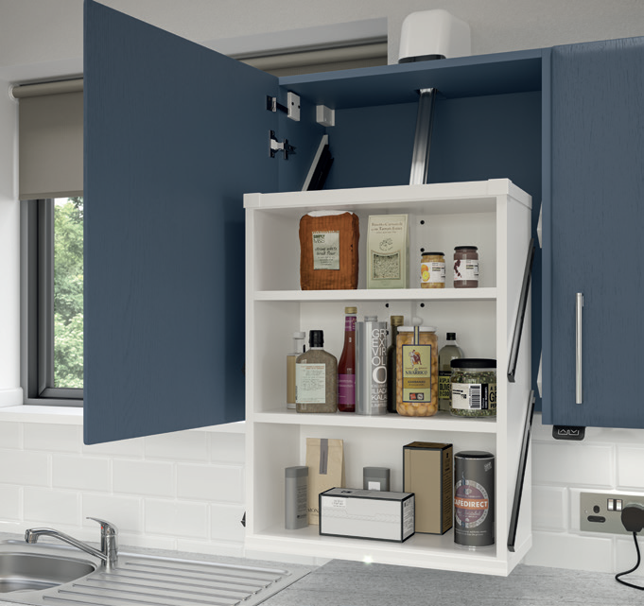
KEY CONSIDERATIONS
UNITS & STORAGE
It’s important to be creative with the available space as all homes are not like a showroom and internal space is lost to increase turning circles
Use the area under the oven for a pan drawer
If space allows for more base units, prioritise drawers over cupboards and incorporate a tall pull-out larder cupboard with access to wire shelves from both sides
Corner units can be fitted with a carousel or wire work
Wall units should be installed no more than 350mm above the worktop and can be fitted with pull-down baskets or ActivMotion Glide shelving inserts (opposite)

Slide 21
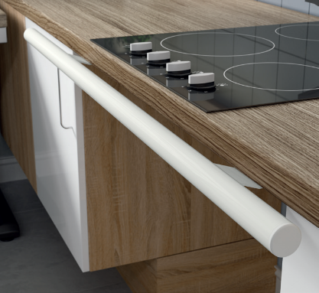
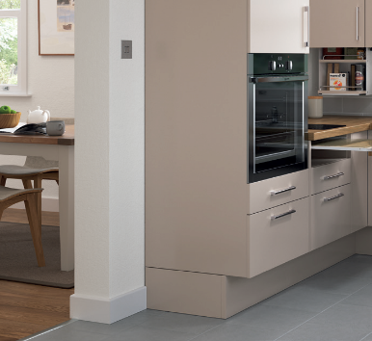
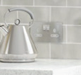
KEY CONSIDERATIONS
SOCKETS, SWITCHES, RAILS & CONTROLS
A minimum of 8 double sockets should be provided in the kitchen (over and above those needed for appliances)
All sockets should be positioned to allow easy access by wheelchair users (see max. measurements in illustrations), with light switches no more than 1000mm, and sockets no more than 900mm where there is no intervening worktop
Using a Grab-a-Rail can support an ambulant wheelchair user when standing to the worktop
Controls need to be accessible, including for extractors; remote extractor controls are available or position the spur in an accessible position which is also a cost-effective solution
1000mm
100mm

Slide 22
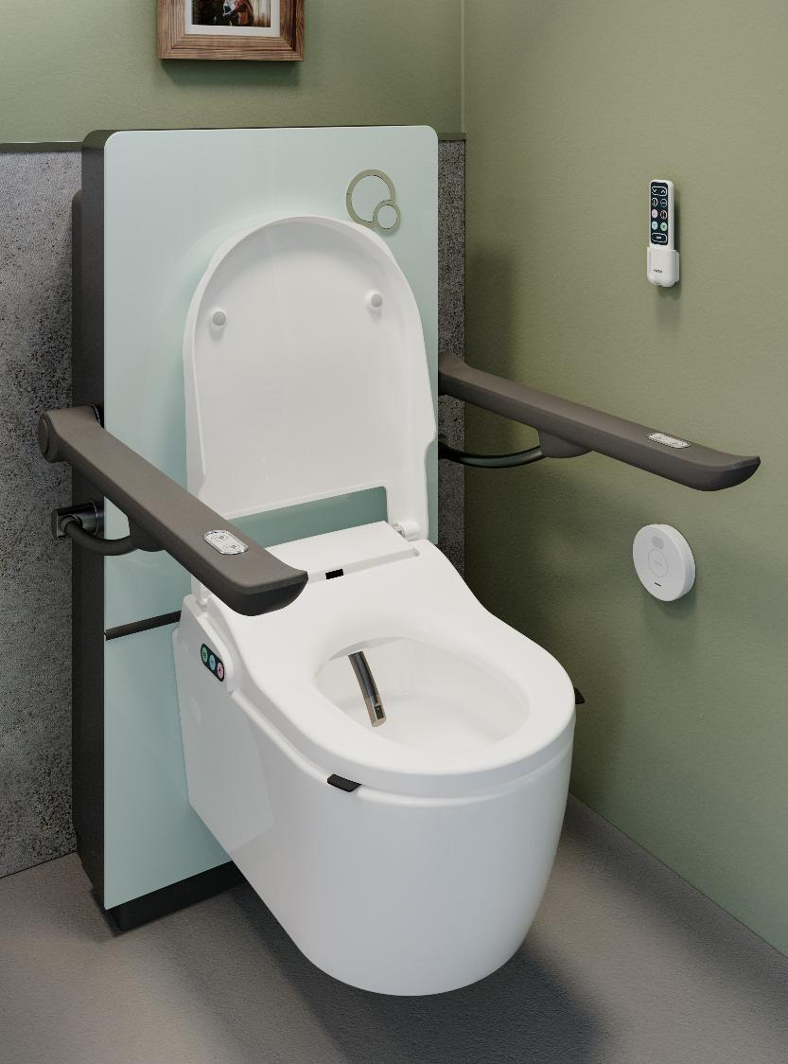
AKW SOLUTIONS
DESIGNED FOR INDEPENDENCE & DIGNITY

Slide 23
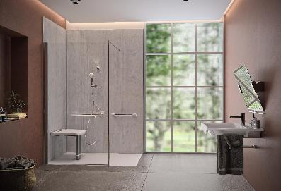
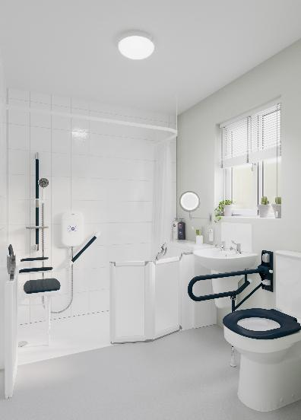
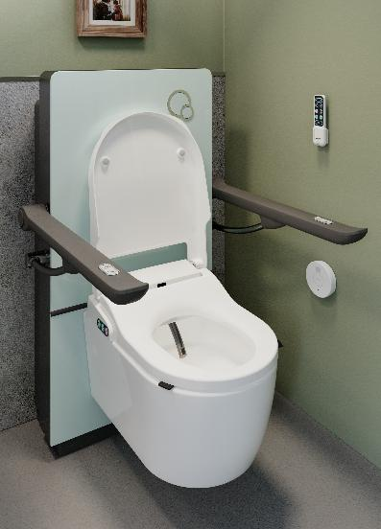
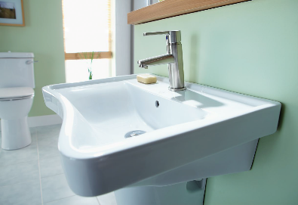
AKW SOLUTIONS – BATHROOM
AKW SMARTCARE PLUS ELECTRIC SHOWER can be operated via a remote, is easy to use and includes a load-bearing riser rail and 2m hose as standard
AKW BIDET COLLECTION offers wash/dry toileting with several solutions that can be installed on a variety of toilet pans
FOLD-UP SHOWER SEATS tuck away when not in use
Level-access wet floor showers are easily achieved with TUFF FORM WET ROOM FORMERS
DOC M RANGE includes raised-height pans, ergonomic seats, grab rails and accessories for different needs
CONCAVE WASH BASINS enable closer access to the sink and tap with a concave front
Notes:
At AKW, we’ve designed a number of practical, inclusive solutions to help with designing and specifying a dementia-friendly bathroom; the first is our range of electric care showers.
Back in 2021, the AKW SmartCare Lever became the first electric shower to be awarded dementia-friendly product accreditation by the experts at the DSDC. In 2024, when we launched our refreshed range of electric showers, both the SmartCare Lever, and the SmartCare Plus were awarded DSDC accreditation thanks to the design improvements made by our team of engineers.
There are several features that help to make these showers suitable for dementia-friendly bathrooms:
The controls on the heater units are designed to be clear and simple to use, with no unnecessary or confusing settings or features
The symbols letters on the unit controls are raised and tactile, and most importantly, offer colour contrast
Each time a temperature or flow setting is adjusted, not only does the LED display visually advise this, but there’s also an audible beep or click to offer additional confirmation
The central control panel of the shower units feature a matt, non-shiny or reflective finish to help reduce glare
A care accessory kit is available which includes a grab riser rail that offers support for up to 23.5st/150kg
This rail is also offered in multiple colours – including white, mid-grey and navy blue, to help offer colour contrast when needed against the wall surface
There are also colour contrasting elements on various parts of the shower kit, such as the adjustable shelf and handset holder

Slide 24
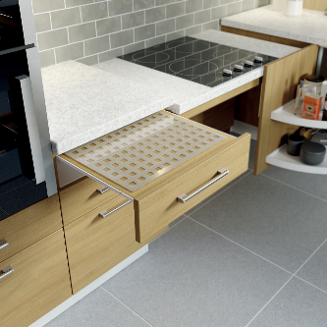

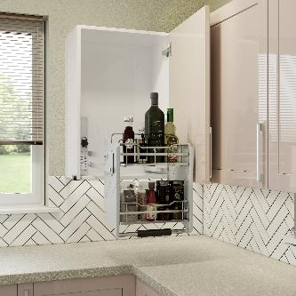
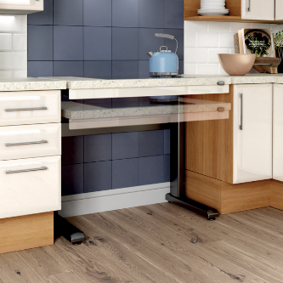
AKW SOLUTIONS – KITCHEN
The height of ACTIVMOTION RISE & FALL WORKTOPS can be easily adjusted at the push of a button and offer greater access to hobs and sinks
For wall cupboard storage, ACTIVMOTION GLIDE WALL UNITS safely descend bringing contents down and outwards
A PULL-OUT HEAT-RESISTANT DRAWER is ideal for transferring hot items from the oven
GRAB-A-RAIL can be installed to offer support when needed
PULL-DOWN OR SWING-OUT BASKETS increase access to storage and can be installed in wall, base and larder units
CORNER CAROUSEL UNITS brings the contents of the cupboard to within much easier reach, utilising often a large space
Notes:
At AKW, we’ve designed a number of practical, inclusive solutions to help with designing and specifying a dementia-friendly bathroom; the first is our range of electric care showers.
Back in 2021, the AKW SmartCare Lever became the first electric shower to be awarded dementia-friendly product accreditation by the experts at the DSDC. In 2024, when we launched our refreshed range of electric showers, both the SmartCare Lever, and the SmartCare Plus were awarded DSDC accreditation thanks to the design improvements made by our team of engineers.
There are several features that help to make these showers suitable for dementia-friendly bathrooms:
The controls on the heater units are designed to be clear and simple to use, with no unnecessary or confusing settings or features
The symbols letters on the unit controls are raised and tactile, and most importantly, offer colour contrast
Each time a temperature or flow setting is adjusted, not only does the LED display visually advise this, but there’s also an audible beep or click to offer additional confirmation
The central control panel of the shower units feature a matt, non-shiny or reflective finish to help reduce glare
A care accessory kit is available which includes a grab riser rail that offers support for up to 23.5st/150kg
This rail is also offered in multiple colours – including white, mid-grey and navy blue, to help offer colour contrast when needed against the wall surface
There are also colour contrasting elements on various parts of the shower kit, such as the adjustable shelf and handset holder

Slide 25
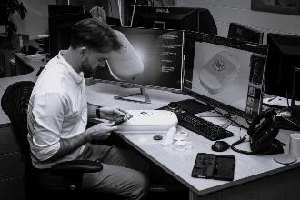
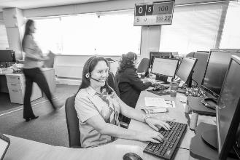
LIFE MADE BETTER
From a small Worcestershire business, AKW has grown into a market-leading international operation:
200+ UK-based colleagues
Over 1 million satisfied customers
World-class manufacturing facilities
Dedicated 30+ vehicle fleet providing door-to-door service
3 national distribution warehouses covering over 3.5m sq. feet
60+ sales and surveying experts nationwide

Slide 26
OUR STORY
1982 | Founded by Anthony Keith Webb in Worcester, UK
1996 | Began manufacturing accessible kitchens
2002 | Launched own range of grab rails and shower seats
2014 | Released dementia-friendly bathroom design guide
2015 | Introduced AKW electric showers and wet room formers
2022 | Contour Showers Ltd acquired
2024 | Opened manufacturing facility, showroom and distribution centre in Middlewich, UK
2025 | Launched AKW Virtual Showroom and Clinical Hub

Slide 28
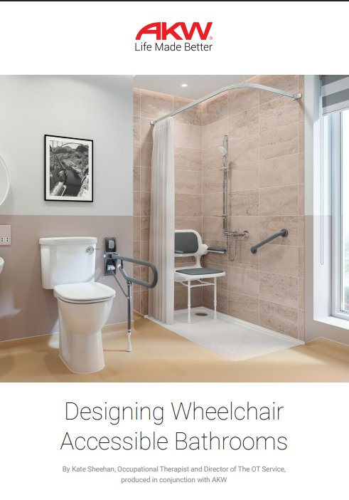
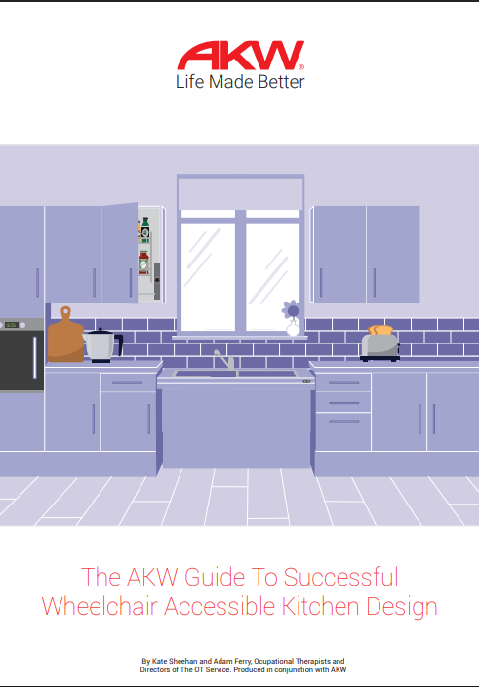
FINAL THOUGHTS
Inclusive design transforms lives, promoting dignity, safety and self-reliance
Accessible spaces should feel homely, not clinical
Good design doesn’t cost more; it just requires foresight and empathy
When accessibility is built in, independence follows naturally
Two design guides are also available to download for free on the AKW website.

Slide 29
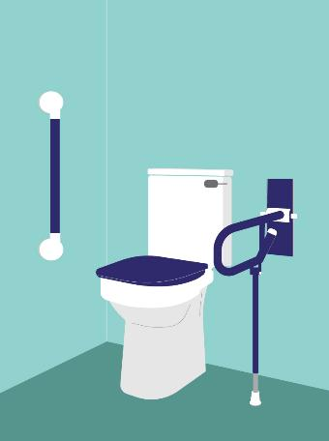

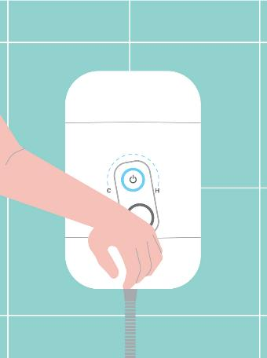


AKW CLINICAL HUB
The AKW Clinical Hub is home to a collection of digital resources designed to offer condition-specific information to support occupational therapists – www.akw-ltd.co.uk/clinical-hub
VISUAL IMPAIRMENT
DEMENTIA
ARTHRITIS
STROKE
WHEELCHAIR ACCESSIBILITY
Notes:
For more product information and best practice design advice on specifying for clients with a range of conditions and care requirements, please visit the AKW Clinical Hub, which is home to a collection of digital resources, including videos and educational guides.

Slide 30
THANK YOU FOR YOUR TIME
PLEASE FEEL FREE TO ASK US ANY QUESTIONS YOU MAY HAVE.
Notes:
Thank you so much for your time today, I hope this session has been beneficial; if you have any questions, please feel free to ask us.

